Slide 1
Warning Signs, Sounds, and Labels

Slide 2
What is this sound?
https://www.youtube.com/watch?v=6Tv6gQgj0VQ

Slide 3
School Bell

Slide 4
What is this sound?
https://www.youtube.com/watch?v=rCQykaL8Hy4

Slide 5
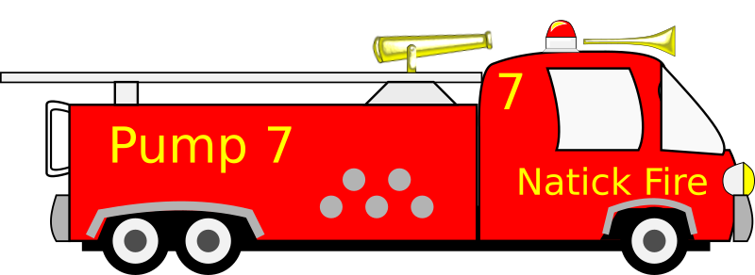
Fire Engine – What Should You Do?

Slide 6
What is this sound?
https://www.youtube.com/watch?v=KE_nZUCuNCY

Slide 7
Ambulance –What Should You Do?

Slide 8
What is this sound?
https://www.youtube.com/watch?v=Djqi86jMl5g

Slide 9
What Should You Do?

Slide 10
What is this sound?
https://www.youtube.com/watch?v=TmQCcE5YA80

Slide 11
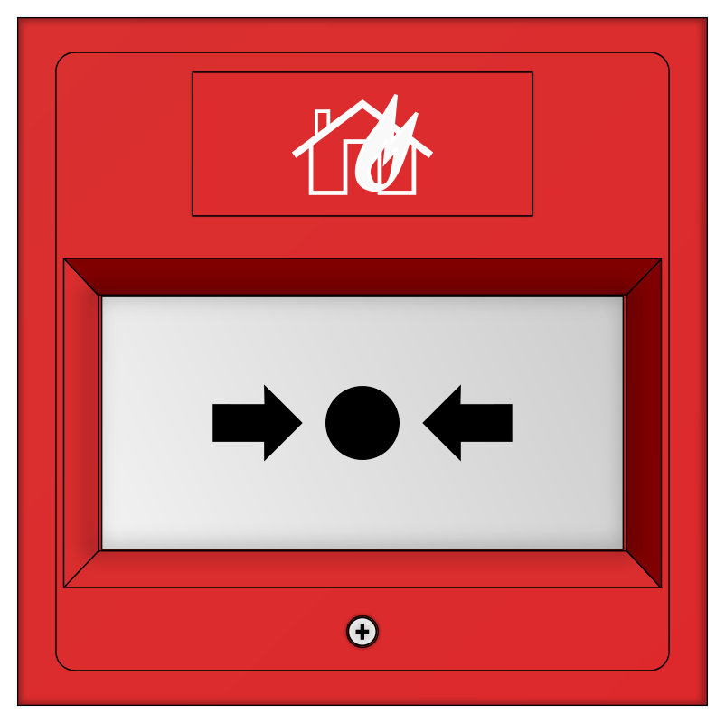
Fire Alarm – What Should You Do?

Slide 12
What is this sound?
https://www.youtube.com/watch?v=1WFLYqsLvv0

Slide 13
Smoke Detector – What Should You Do?

Slide 14
What Does this Sign Mean?

Slide 15
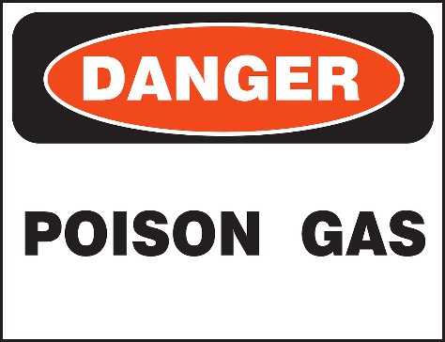
What Does This Sign Mean?

Slide 16
What Does this Sign Mean?

Slide 17
What Does This Sign Mean?

Slide 18
What Does This Sign Mean?

Slide 19
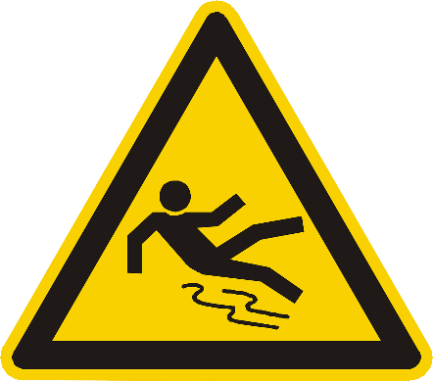
What Does This Sign Mean?

