Slide 1
How to Get Help in an Emergency
K.PCH.2.3

Slide 2
Is this an emergency?
YES
NO
You see a fire in your house.
A friend falls off his skateboard and is not moving or talking.
Joey sees a car hit another car and people are badly hurt.
Carlo is allergic to peanuts and he ate a cookie that had peanuts in it for lunch. His lips start to swell and he is having trouble breathing.
John’s sister is on the computer and he wants a turn.
Charla cannot find her puppy.
I scraped my knee.
Ki’s brother ate candy before dinner.
The fence gate is stuck and I cannot get to the swing set.

Slide 3
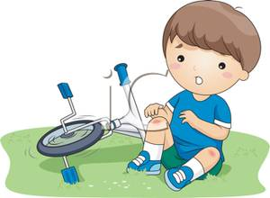
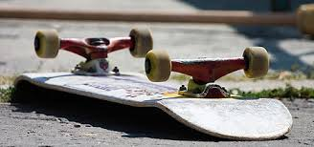
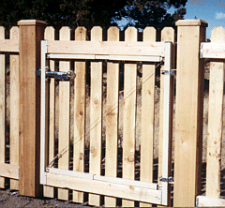
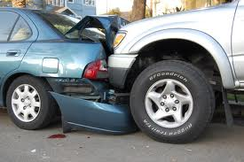
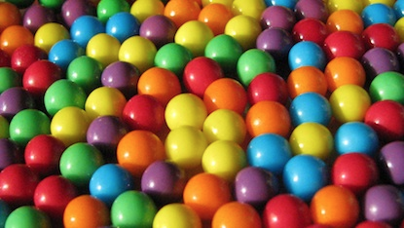
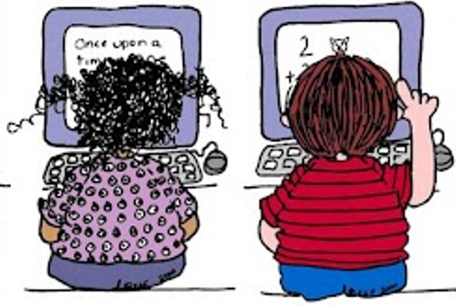
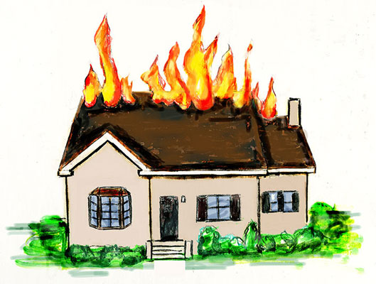
Is this an emergency?
Yes
No

