Slide 1
Safety & Traffic Signs and Signals

Slide 2
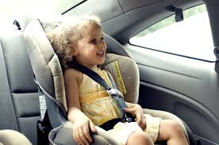
Seat Belts

Slide 3
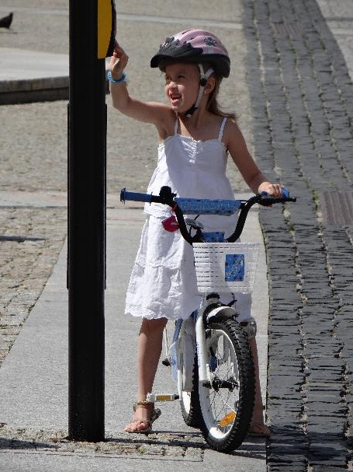
Bike Helmets
By Adam Jones from Kelowna, BC, Canada - Girl on Bike at Crosswalk - Bialystok - Poland, CC BY-SA 2.0, https://commons.wikimedia.org/w/index.php?curid=64117655

Slide 4
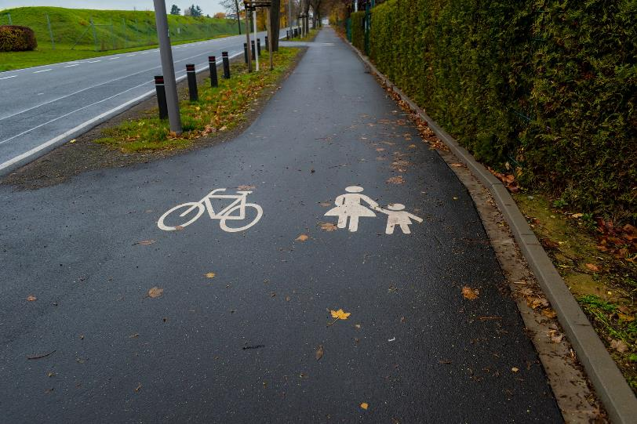
Use Sidewalks & Bike Lanes

Slide 5
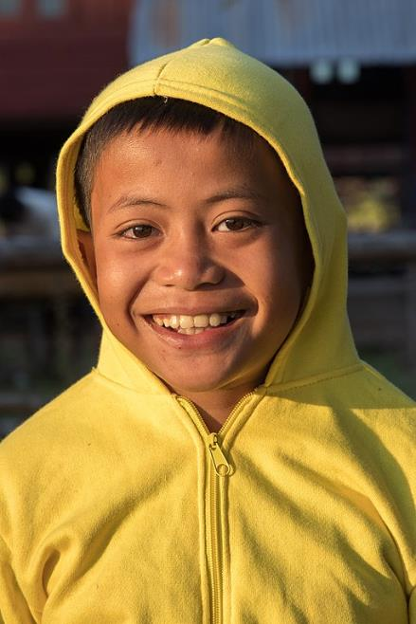
Wear Bright Colors

Slide 6
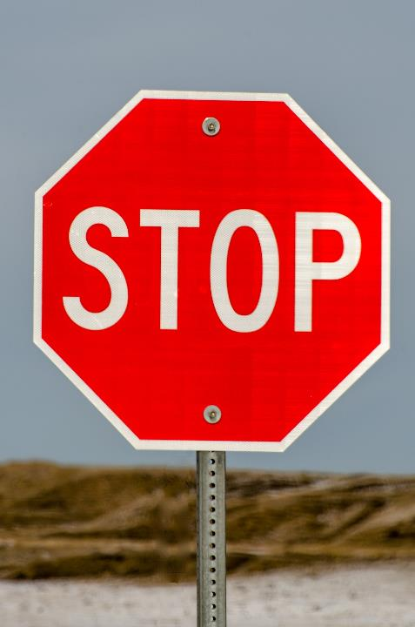

Slide 7
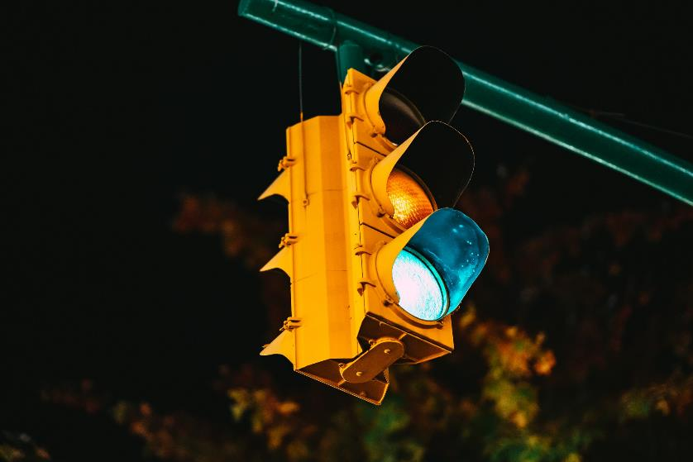

Slide 8
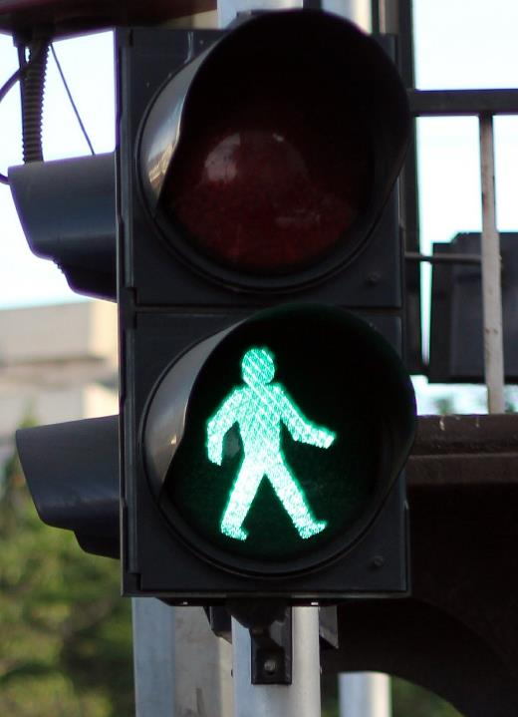
Walk Signal

Slide 9
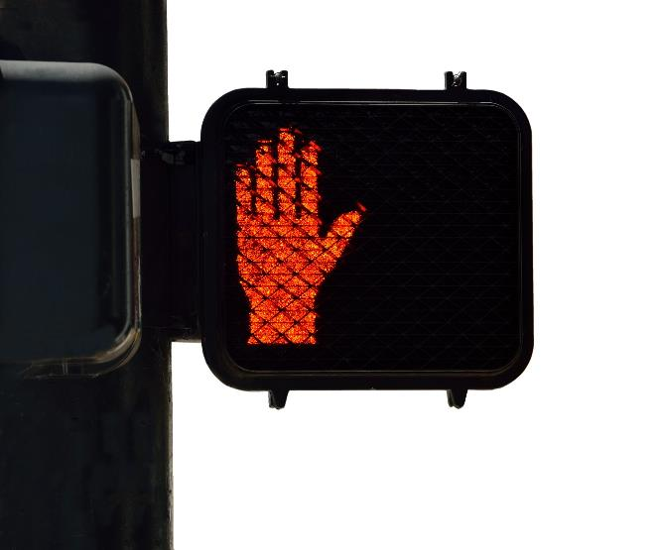
Don’t Walk Signal

Slide 10
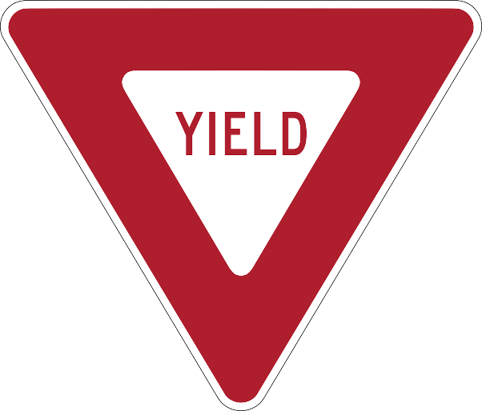
Yield Sign

Slide 11
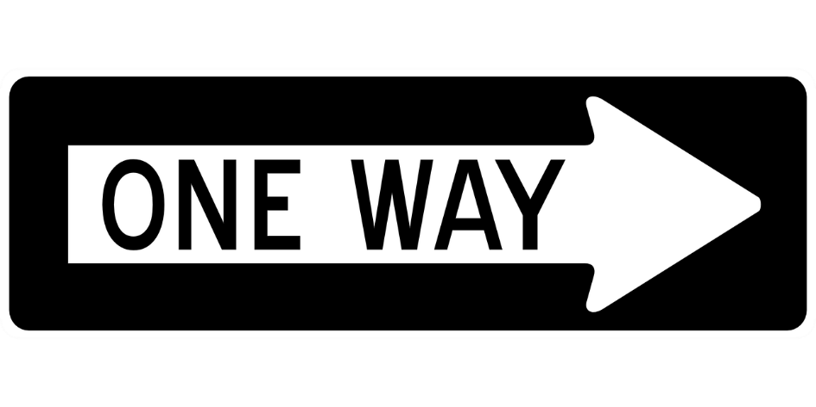
One Way Sign

Slide 12
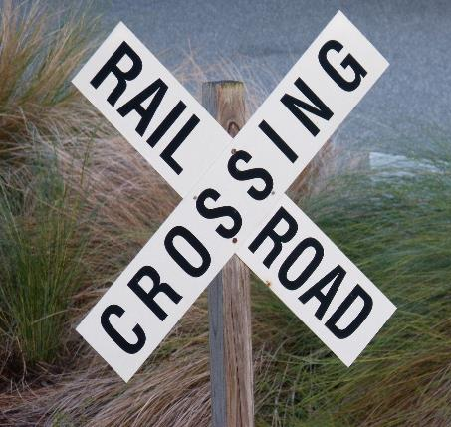
Railroad Crossing Sign

Slide 13
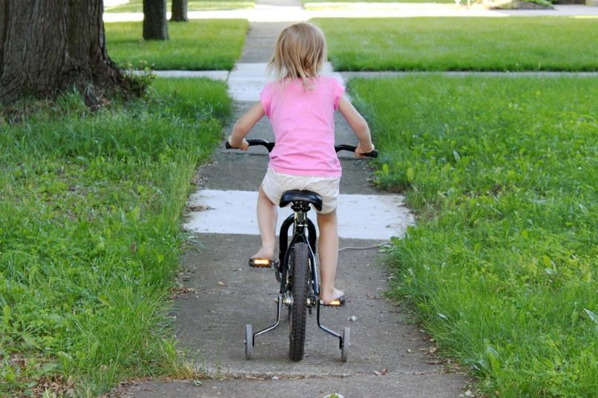
Josie

