Slide 1
Personal Responsibility

Slide 2
It wasn’t me!

Slide 3
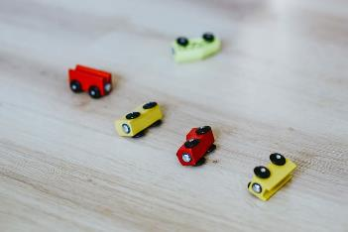
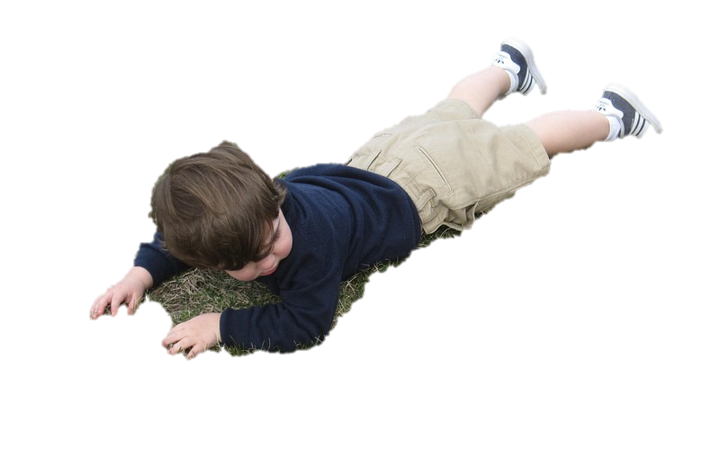
Cause & Effect
Someone trips and falls
Toys are left in the floor
Cause
Effect

Slide 4
Jumping in a Puddle
Muddy Shoes

Slide 5
Practicing your soccer kick
Scoring a goal in a soccer game

Slide 6
You practice throwing the ball in the house.
A glass plate gets broken

Slide 7
You study your site words.
You get a good score on the reading assignment.

Slide 8
You stay up watching TV after your parents tell you to go to bed.
You are tired all day at school.

Slide 9
You eat a lot of candy don’t brush your teeth.
You develop a cavity in your teeth and have to get a filling.

Slide 10
Cause & Effect
What if everybody
did that?

