Slide 1
Stranger Safety Rules
K.ICR.1.3 – Summarize protective behaviors to use when approached by strangers.

Slide 2
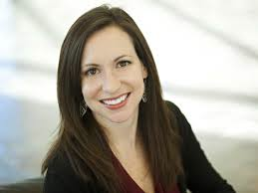
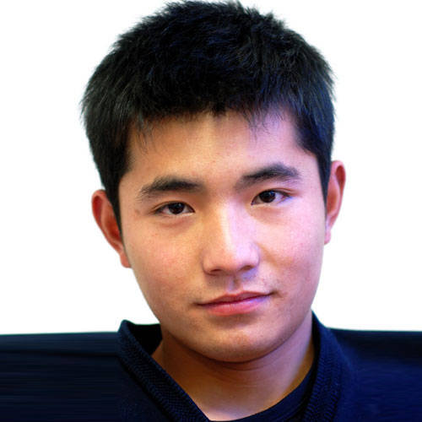
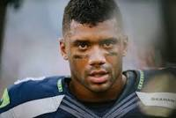
Which person is a stranger?

Slide 3
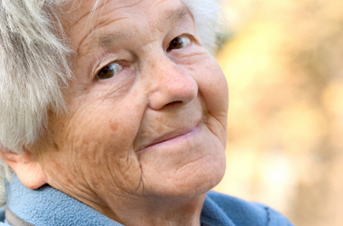
Which person is a stranger?

Slide 4
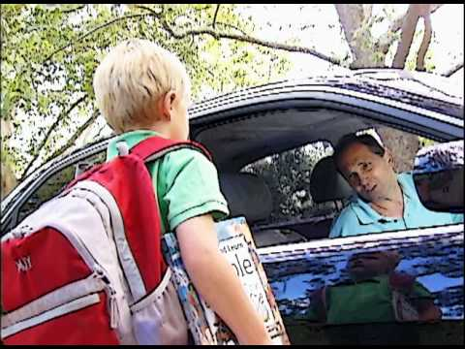
What should Tommy do?

Slide 5
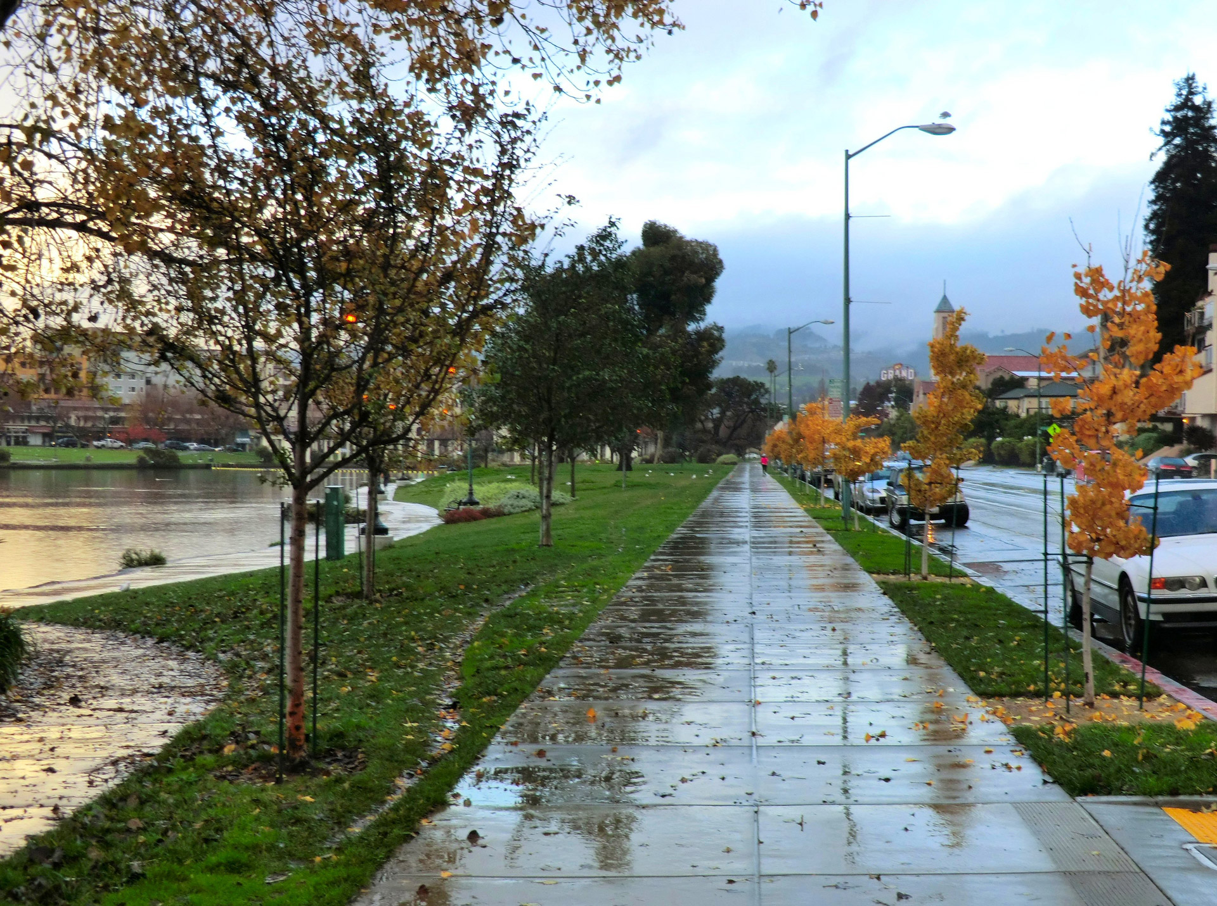

Slide 6
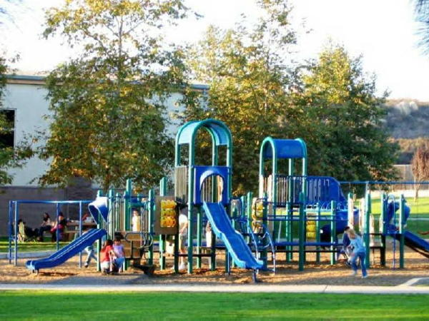

Slide 7
