Slide 1
Circulatory System
Link to video: https://kidshealth.org/en/kids/csmovie.html#catmovies

Slide 2
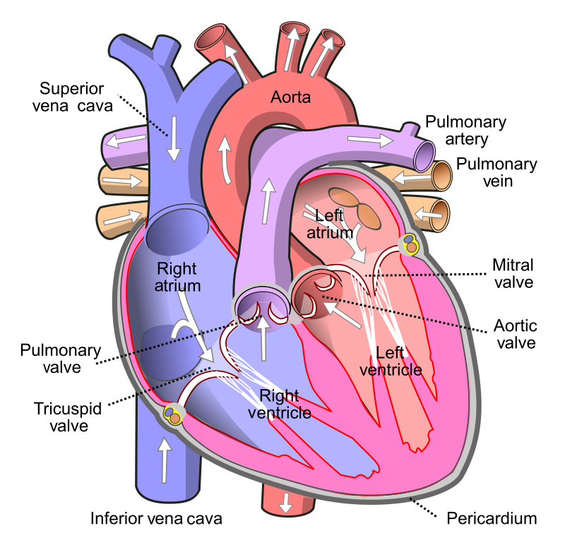
Heart Parts
Aorta
Valves
Ventricle (R+L)
Atrium (R+L)
Vena cava
https://en.wikipedia.org/wiki/Human_body#/media/File:Diagram_of_the_human_heart_(cropped).svg

Slide 3
Parts of Blood
Plasma
Red blood cells
White blood cells
Platelets

Slide 4
Vessels
Arteries
Veins
Capillaries

Slide 5
More Terms
Heart rate
Pulse
Blood pressure

Slide 6
How to Be Heart Healthy
Say “No” to tobacco
Eat foods low in fat and sugar
Get 60 minutes of exercise daily
Maintain healthy weight

