Slide 1
Getting Your ZZZZZs with Ease

Slide 2
What’s Going on During Sleep?
You are taking a break
Brain is sorting and storing information
Brain is solving problems
Body is growing

Slide 3
How Much Sleep Do I Need?
5th graders need 9 to 10 hours each night
Younger students need more; teens need slightly less
Adults need 7-8 hours
Individuals vary

Slide 4
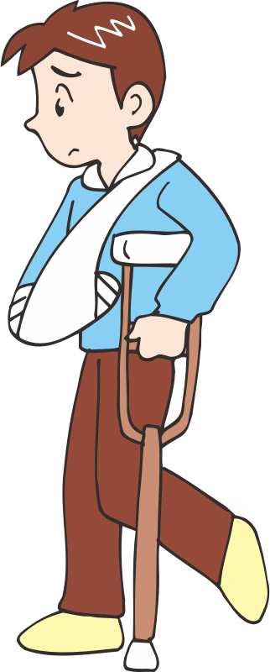
Lack of sleep causes . . .
Inability to pay attention
Poorer grades
Lower or inconsistent athletic performance
Slow responses
Dull concentration
Increase in accidents
Low energy
Irritability

Slide 5
How Do I Know if I Need More Sleep?
Feeling groggy
Trouble waking up
Falling asleep while reading, watching TV, or in class
Yawning

Slide 6
How Can I Get Better Sleep?
Stay on a schedule
Practice calming activities before bedtime
Avoid caffeine
Do not have a TV in your room
Exercise earlier in the day, not just before bedtime
Use your bed just for sleeping
All images: Openclipart.org

