Slide 1
Weight Gain and Body Changes During Puberty

Slide 2
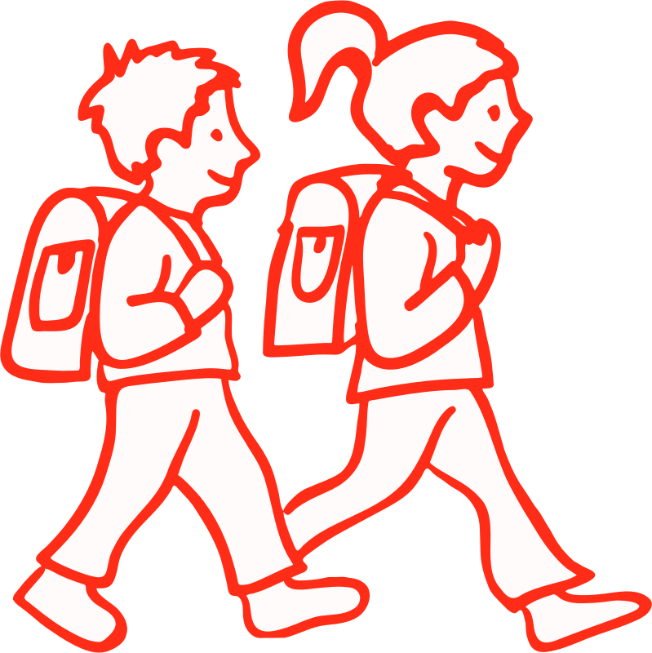
Puberty
Puberty is a period of growth triggered by hormones that includes the
development of secondary sex characteristics
Lower voice, pubic hair, body hair, broader shoulders, and facial hair in boys
Breasts, wider hips, pubic hair in girls
beginning of reproductive capacity
Girls can become pregnant because their ovaries release ova (eggs) that can be fertilized (ovulation and menstruation)
Boys produce sperm that can fertilize an ovum

Slide 3
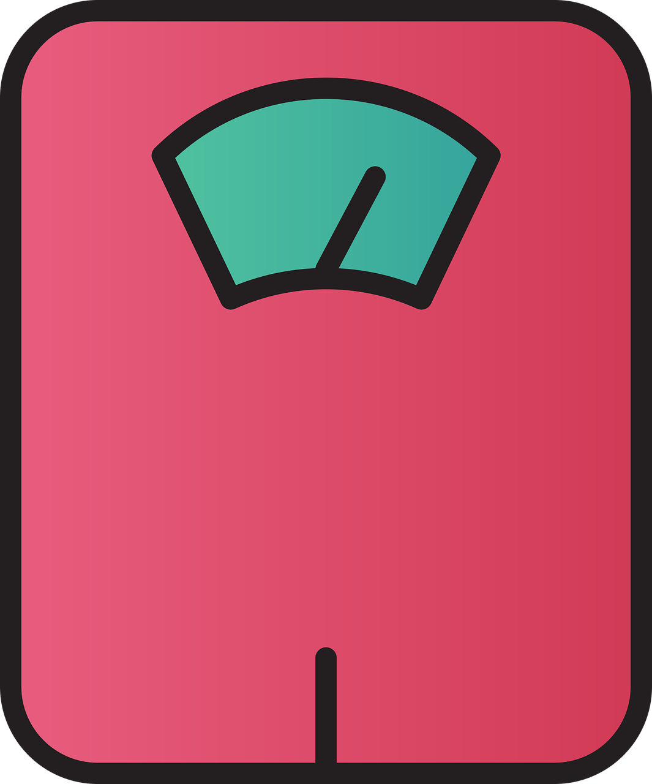
What is Average?
Puberty may start as early
as age 8, or not until age 14
Changes continue for several years
A person may grow 10” in height during puberty
Weight gain occurs during puberty because of rapid growth
Weight gain is healthy as long as body fat, muscle, and bone are in the right proportion

Slide 4
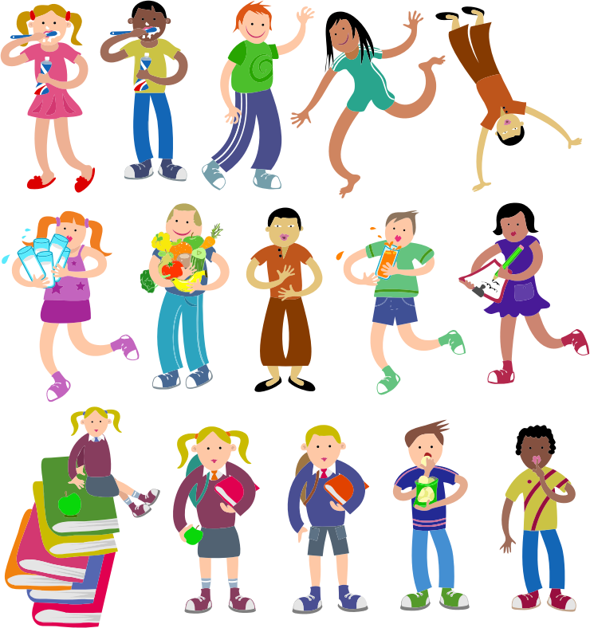
Individual Differences
People have different body types
Everyone develops on own schedule
Some are early, middle, or late “maturers”
Girls develop one to two years before boys
It is normal for two children who are the same gender, age, and height to have different weights

Slide 5
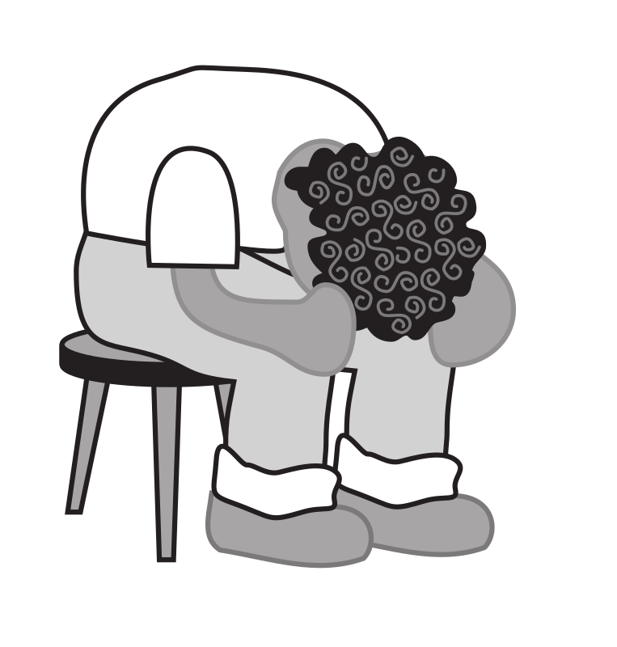
Emotions and Self-Esteem
Hormones affect emotions as well as the body
Mood swings are common
Kids may feel self-conscious about how bodies are changing
A positive body image contributes to healthy self-esteem

Slide 6
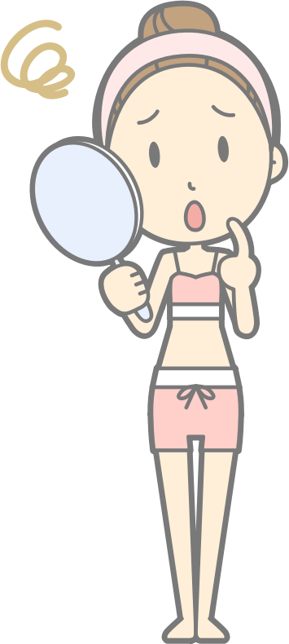
Body Image
Definition: perception of one’s body
Affects self-esteem
Influences health behavior
Affected by positive or negative self-talk

Slide 7
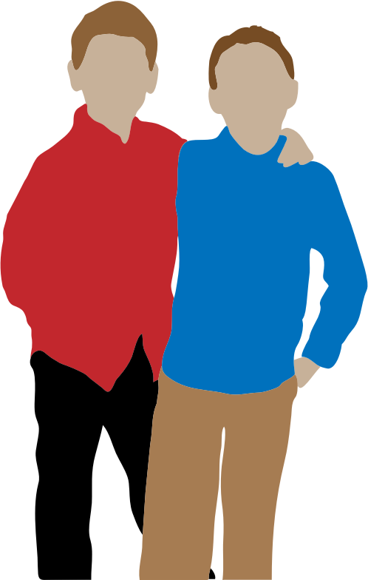
Media Influence
Boys worry about being too small
Girls worry about being too big
Self-comparison with models or athletes (or toys) does not contribute to well-being

Slide 8
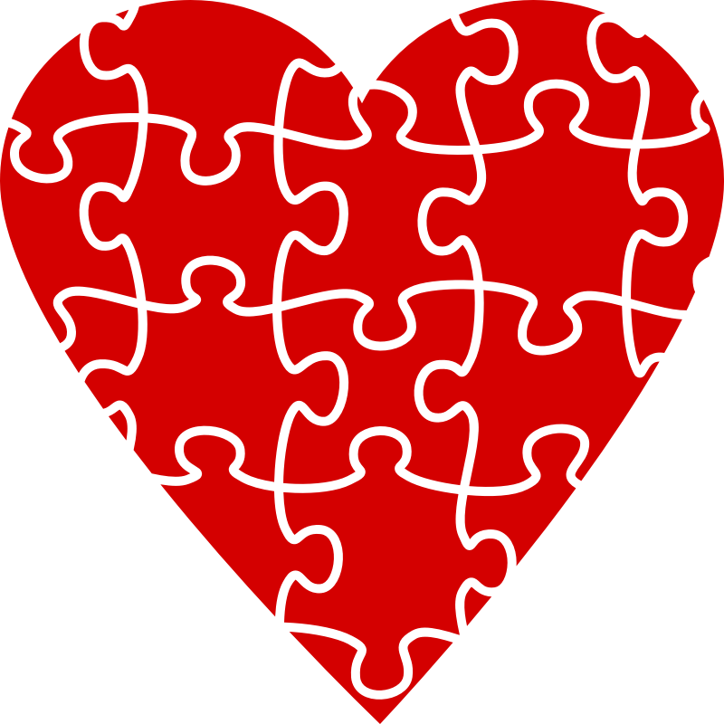
https://www.youtube.com/watch?v=z2T-Rh838GA
What did you learn?
Why do you think kids, and adults, edit their media content?
What would be the benefit of not editing your content?

Slide 9
Advice about Weight and Body Image during Puberty
Heredity and race/ethnicity play a role in body shape, weight, and how fat is distributed
Be patient . . . your body may continue to change through adolescence
Control what you can:
Eat nutrient-dense foods instead of high-calorie, high-fat foods
Get 60 minutes of vigorous exercise each day

Slide 10
Measuring BMI
A calculation of whether someone is in the healthy weight range for his/her height
Different charts for boys and girls
Healthy weight = greater than 5th percentile and less than the 85th percentile

Slide 11
“Self-Talk” Affects Body Image

Slide 12
Be – YOU – tiful!
Strive for:
Health,
Fitness, and
Inner beauty.
All Clipart: https://openclipart.org/

