Slide 1
Choosing Nutrient-Dense Foods
5.NPA.2.2
5.NPA.3.1

Slide 2
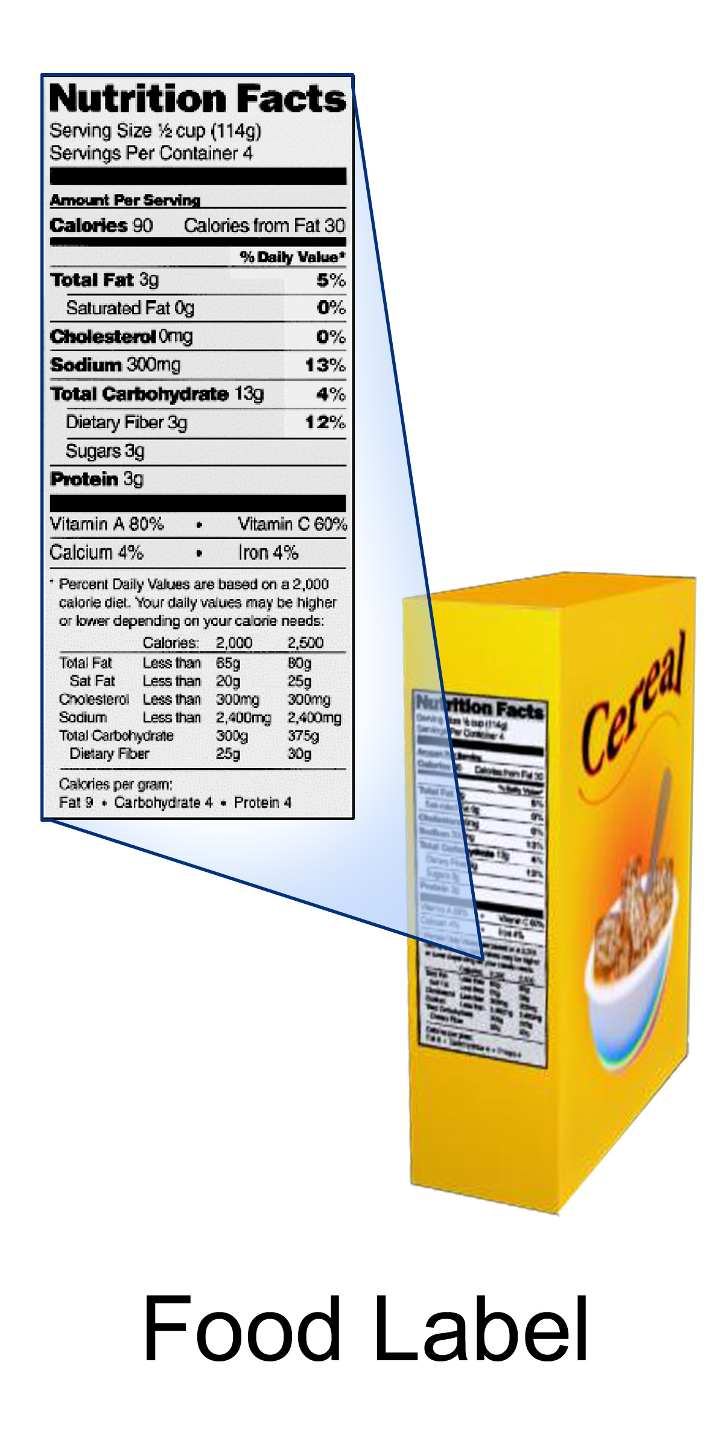
Interactive Food Label
Interactive Nutrition Label: https://www.accessdata.fda.gov/scripts/InteractiveNutritionFactsLabel/#intro
https://commons.wikimedia.org/wiki/File:Food_Label.png

Slide 3
Empty Calories
Calories from food components, such as solid fats and added sugars, that provide little nutritional value
Part of Total Calories listed on the food label
Empty Calories from solid fats or added sugars can also be found in other foods.

Slide 4
Most Candies and Sodas are Empty Calories
Food | Amount | Estimated Total Calories | Estimated Empty Calories
Regular soda | 12 ounce can | 136 | 136
Regular soda | 20 ounce bottle | 192 | 192
Fruit-flavored drink | 8 ounces (1 cup) | 128 | 128
Source: https://www.choosemyplate.gov/amount

Slide 5
Sugar in Foods
Recommended daily amount is: 40 grams.
40 grams = 10 teaspoons.
Do you think you go over
the recommended level
each day?

Slide 6
What about Milk?
Whole milk
https://tools.myfooddata.com/nutrition-facts/171265/wt9
Chocolate milk
https://tools.myfooddata.com/nutrition-facts/170880/wt1/1

Slide 7
What about Yogurt?
Plain yogurt
https://tools.myfooddata.com/nutrition-facts/171284/wt4/1
Silk peach soy yogurt
https://tools.myfooddata.com/nutrition-facts/173779/wt1/1
Lowfat Greek vanilla yogurt
https://tools.myfooddata.com/nutrition-facts/170907/100g/1

Slide 8
Effect on Health of High-Fat Food Consumption
Weight gain/obesity
High blood cholesterol
High blood pressure
Heart disease (heart attack, stroke)
Some types of cancer

Slide 9
Effect on Health: Sugar
Weight gain/obesity
Dental caries
Increased risks for developing Type 2 Diabetes
Slower immune system
Lower good cholesterol (HDL)
Higher bad cholesterol (LDL)

Slide 10
Limiting Fats
Use less butter and stick margarine
Look for the lower fat versions
Eat foods that are naturally low in fat: whole grains, fruit, and vegetables
Limit fried food, processed foods, and baked goods
Read the food label
Limit of solid fats when cooking
Choose lean meats
Trim fat from meat
Notes:
Recommendations Source: http://health.nytimes.com/health/guides/nutrition/fat/overview.html
Choose lean, protein-rich foods such as soy, fish, skinless chicken, very lean meat, and fat-free or 1% dairy products.
Eat foods that are naturally low in fat such as whole grains, fruits, and vegetables.
Get plenty of soluble fiber such as oats, bran, dry peas, beans, cereal, and rice.
Limit fried foods, processed foods, and commercially prepared baked goods (donuts, cookies, crackers).
Limit animal products such as egg yolks, cheeses, whole milk, cream, ice cream, and fatty meats (and large portions of meats).
Look at food labels, especially the level of saturated fat. Avoid or limit foods high in saturated fat.
Look on food labels for words like "hydrogenated" or "partially hydrogenated" -- these foods are loaded with bad fats and should be avoided.
Liquid vegetable oil, soft margarine, and trans fatty acid-free margarine are preferable to butter, stick margarine, or shortening.
Children under age 2 should NOT be on a fat-restricted diet because cholesterol and fat are thought to be important nutrients for brain development.

Slide 11
Limiting Sugars
Choose fewer and smaller portions of foods and drinks that are high in sugar
Look for similar versions with no added sugar
Read the food label
Limit added sugar when cooking or eating

Slide 12
Nutrition Paper Explains . . .
Benefits and importance of a diet that is lower in fat.
Benefits and importance of a diet that is lower in sugar.
How intake of low-fat and low-sugar foods and drinks can help maintain a healthy weight.
Changes students want to make to lower their intake of fat and sugar.

