Slide 1
Sadness, Depression, and Getting Help

Slide 2
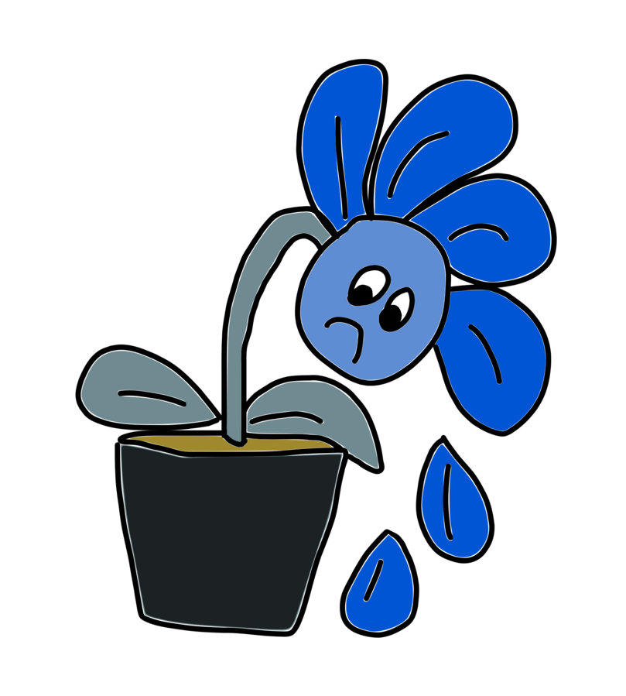
Sadness
Emotional pain
Normal response to loss
Everyone feels sad sometimes
Helps us appreciate happiness
https://commons.wikimedia.org/wiki/File:Sad_Flower_-_FREE_(50210831957).png

Slide 3
Depression
A deeper sadness
Lasts longer
May have physical symptoms
More difficult to overcome
http://clipart-library.com/clipart/depression-cliparts_7.htm

Slide 4
How Might Sadness or Depression Feel?
Feeling “blue”
Loss of joy
Tiredness
Feelings of worthlessness
Hopelessness
Feeling anxious
https://commons.wikimedia.org/wiki/File:Light_Rain_Cloud.png

Slide 5
What Might Trigger Sadness?
Death of a loved one: pet or person
Moving away
Separation or divorce of parents
Big changes
https://openclipart.org/image/400px/293665

Slide 6
Getting Help for Sadness
Spending time with friends
Talking with a counselor, nurse, or trusted adult
Physical activity
Healthy nutrition
Journaling
Creating a memory box
https://pixabay.com/vectors/children-playing-exercise-play-310223/

Slide 7
Memory Box
Decorate a colorful box
Collect mementos that are meaningful
Find a good place to store the box so it can be found when needed
Enjoy the memories
https://pixabay.com/vectors/box-red-open-empty-treasure-chest-37328/

