Slide 1
Managing Stress
5.MEH.1.1
Implement positive stress management strategies.
5.MEH.1.2
Evaluate the effectiveness of stress management strategies.

Slide 2
What are some things that:
cause you to worry?
make you nervous?
make you sad?
make you discouraged?
make you mad?

Slide 3
Stressors
Physical stressors – illness, injury, operation
Mental stressors – tests, projects
Social stressors –
argument with friend, making a new friend

Slide 4
Stressors . . .
Can be positive or negative.
Occur every day.
Can be negative for one person and positive for someone else.

Slide 5
Warning Signs
Physical:
Headache
Dry mouth
Sleeplessness
Tiredness
Muscle tension/aches
Loss of appetite or over-eating

Slide 6
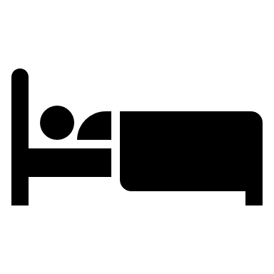
Warning Signs
Emotional/Mental:
Frustration
Depression
Lack of concentration
Irritability
Confusion
Forgetfulness
Feeling overwhelmed

Slide 7
Stress Management Techniques
Time management
Good communication skills
Deep breathing
Exercise
Progressive muscular relaxation

Slide 8
Time Management
Make a schedule using a calendar, planner, or notebook.
See if you have time for everything.
Rank from most important to least important.
Do the important things..

Slide 9
Communication Skills
Express your feelings instead of keeping them inside.
Keep a journal.
Talk to friends, parents, or guardians.

Slide 10
Deep Breathing
Take slow, deep breaths.
Place your hand on the abdomen. This is the part of the body that should be rising and falling when you are doing deep breathing.
zzzzzzzzz
When could you use deep
breathing to calm down
and reduce stress?

Slide 11
Exercise
Strenuous exercise causes a release of chemicals, called endorphins, which . . .
keep energy levels up
make a person feel good
help the person sleep

Slide 12
Progressive Muscular Relaxation
Starting at either the head or the feet, contract and relax each group of muscles for three to five seconds.
Repeat the contraction/relaxation three times.
Do this for all the muscle groups.

Slide 13
Group Activity
Read the situation aloud to your group.
Decide what the stressor is.
Take turns brainstorming stress management skills to cope with the situation.

Slide 14
Storybook
In your storybook, choose a stressor from your life.
Describe three stress management techniques you could use to cope and reduce stress.
Select “Create.”
www.storybird.com/

