Slide 1
Essential Question: Why is it important to be able to identify reliable sources of information to use when researching information on puberty?

Slide 2
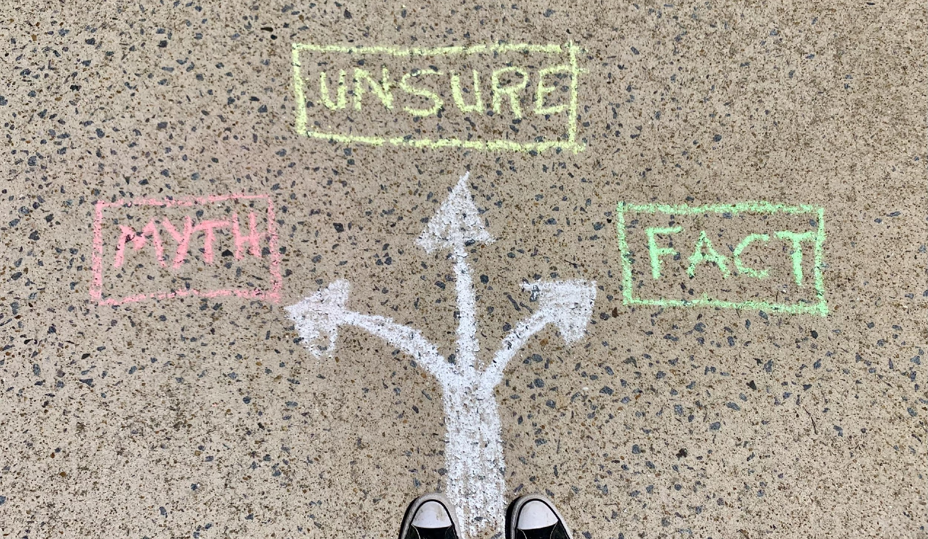
Red Card = MYTH
Yellow Card = UNSURE
Green Card = FACT

Slide 3
You can decide when your body will go through puberty.
MYTH
(Your pituitary gland determines when puberty begins)

Slide 4
Your whole body starts as a single cell.
FACT

Slide 5
Males and females go through mood swings during puberty.
FACT

Slide 6
During puberty males begin to menstruate and will begin having a period every month.
MYTH
(Only females menstruate)

Slide 7
The ovaries produce the hormone testosterone.
MYTH
(Ovaries produces estrogen and the testes produce testosterone)

Slide 8
Females are born with every egg they will have.
FACT

Slide 9
The bladder produces and stores sperm.
MYTH
(the testes produce sperm)

Slide 10
Puberty – where to find accurate information

Slide 11
Why is puberty such a confusing time?

Slide 12
Reliable, Accurate, Dependable – Oh My!
Reliable – consistent, good quality information
Accurate – correct in all details (exact)
Dependable – deserving of trust

Slide 13
Common questions asked by students
Why am I in a bad mood?
Will puberty ever start for me?
What do I do if the teacher calls me to the front of the room and I have an erection?
What should I do if I get my period during school?
How do I tell someone that I "like them, like them"?
When will the rest of my classmates start puberty?

Slide 14
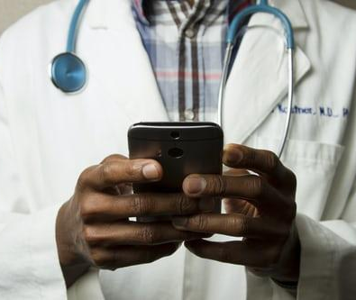
Who can answer my questions?

Slide 15
What about the library??

Slide 16
What about the internet?

Slide 18
What about friends and peers??

Slide 19
