Slide 1
Essential Question: What is the importance of being able to identify the signs of puberty in terms of physical and emotional signs? How will this knowledge help you better understand what is occurring with your body?

Slide 2
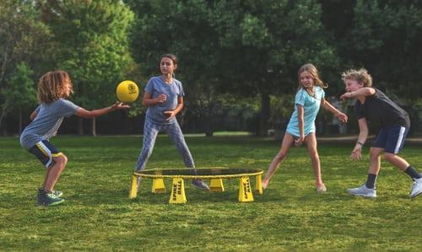
Puberty Review
What is puberty?
At what age does puberty start?
Is puberty normal?

Slide 3
Who can you talk to if you are anxious, concerned, or worried about puberty?

Slide 4
What is the only system of the body that is different for males and females?

Slide 5
Male Reproductive System
Functions
Produce testosterone
Produce sperm

Slide 6
Female Reproductive System
Functions
Produce progesterone and estrogen
Mature and release ovum/egg

Slide 7
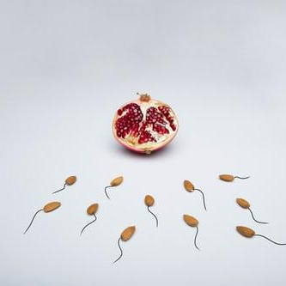
Conception

Slide 8
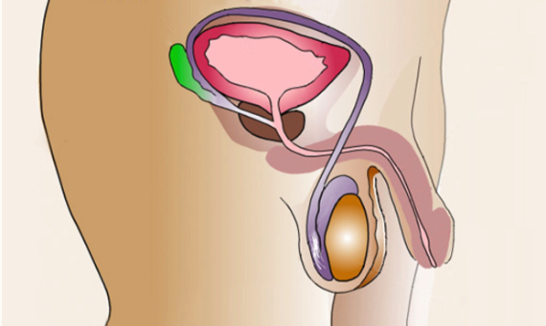
Male Reproductive System
Seminal Vessicle
Bladder
Vas Deferens
Prostate Gland
Urethra
Penis
Cowper's Gland
Epididymis
Scrotum
Testicle
Information provided by KidsHealth.org from Nemours Children’s Health. © 1995-2021. The Nemours Foundation/KidsHealth®. Reprinted following guidelines.

Slide 9
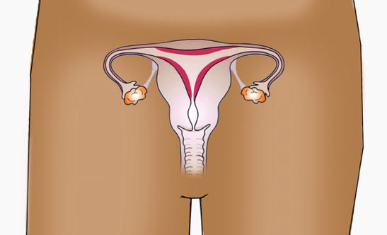
Internal Female Anatomy
Fallopian Tube
Fallopian Tube
Uterus
Ovary
Ovary
Cervix
Vagina
Information provided by KidsHealth.org from Nemours Children’s Health. © 1995-2021. The Nemours Foundation/KidsHealth®. Reprinted following guidelines.

Slide 10
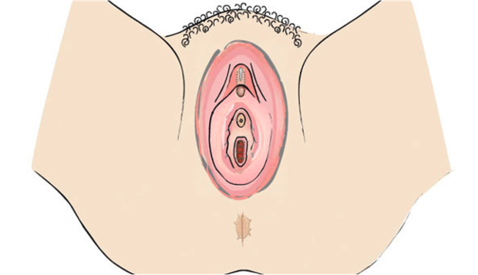
External Female Anatomy
Clitoris
Urethra
Labia
Vaginal Opening
Anus
Information provided by KidsHealth.org from Nemours Children’s Health. © 1995-2021. The Nemours Foundation/KidsHealth®. Reprinted following guidelines.

