Slide 1
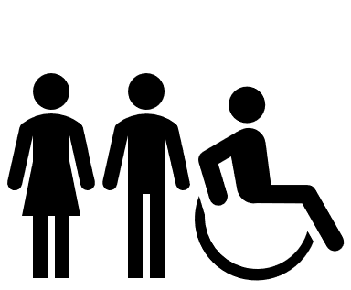
R-E-S-P-E-C-T
5.ICR.1.3 Explain the impact of stereotyping and discrimination on other people’s self-respect and feelings.

Slide 2
Stereotype
A form of prejudice
An oversimplified opinion
A widely held (but often inaccurate) belief about a particular person or thing
Prevents us from seeing people as individuals
May cause us to reject someone without really knowing them

Slide 3
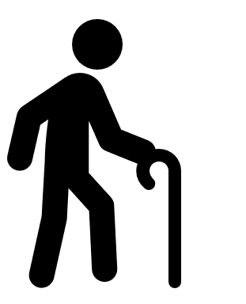
Discrimination
Treating someone unfairly because he or she is different
May be the result of stereotypes
May be part of bullying behavior
Hurts the self-esteem and feelings of others
Prevents healthy relationships

Slide 4
Tolerance
Being open-minded
Accepting others
Avoiding prejudices
Appreciating differences

Slide 5
Be a Tolerance Advocate
Appreciate that we have more in common than we have differences
Realize we are all different in some ways
Look for what is positive in others
Stand up for others
hate

Slide 6
How to Become Tolerant
If we could look into each other’s hearts and understand the unique challenges each of us faces, I think we would treat each other much more gently, with more love, patience, tolerance, and care.
Marvin J. Ashton

