Slide 1
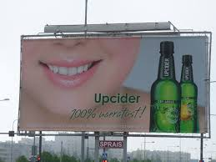
How are Alcohol Advertisements Intended to Appeal to YOU?

Slide 2
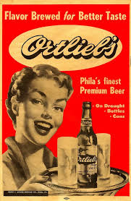
#1

Slide 3
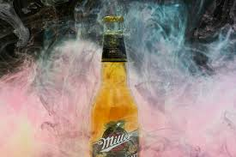
#2

Slide 4
#3

Slide 5
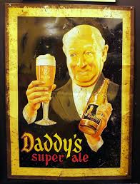
#4

Slide 6
#5

Slide 7
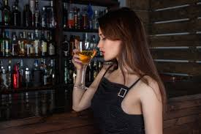
#6

Slide 8
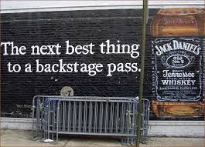
#7

Slide 9
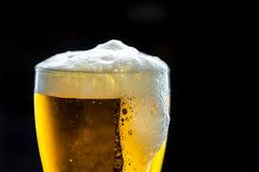
#8

Slide 10
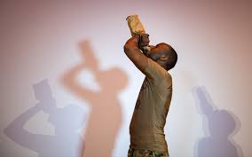
#9

Slide 11
#10

Slide 12
#11

Slide 13
#12

