Slide 1
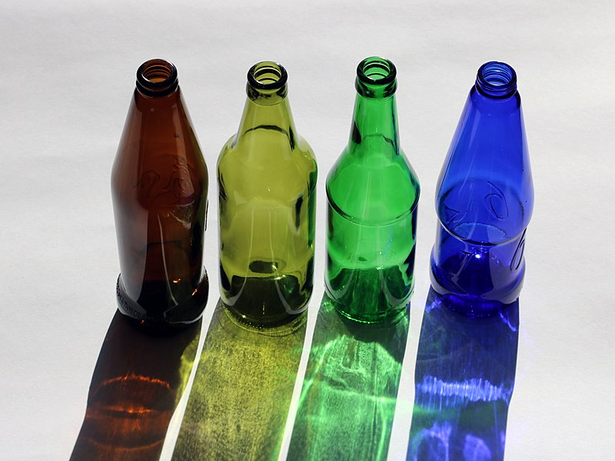
How Alcohol Affects the Drinker and Others
https://commons.wikimedia.org/wiki/File:Beer_bottles_2018_G1.jpg

Slide 2
What is Alcohol?
The most widely used drug
A beverage that contains ethanol (a depressant that slows down the body)
Beverages that can have an intoxicating effect
https://commons.wikimedia.org/wiki/File:Alcohol_-_The_Noun_Project.svg

Slide 3
Alcohol Use
Alcohol is a drug and is illegal for anyone under the age of 21
Many adults use alcohol in a responsible way
Some use alcohol in ways that are unhealthy and dangerous
https://pixabay.com/photos/alcohol-whiskey-drink-party-people-492871/

Slide 4
Intoxication and Short-Term Effects
Measured by Blood Alcohol Content (BAC)
The drinker becomes less in control of his or her body and behavior
Reactions may include:
Friendliness and confidence (at first)
Flushed skin, perspiration
Shortened attention
Impaired judgment
Loss of coordination, lack of balance, dizziness
Blurred vision

Slide 5
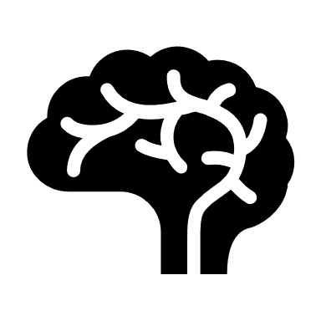
Hangover
After effects of drinking too much
Unpleasant physical effects of too much alcohol
Symptoms include:
Tiredness
Thirst
Headache
Nausea, vomiting
Poor sleep
Dizziness
Bloodshot eyes
Shakiness
Inability to concentrate
Moodiness: sadness and irritability
Rapid heartbeat

Slide 6
Alcohol Poisoning
Severe intoxication
BAC at dangerous levels
Symptoms include:
Confusion, impaired judgment
Impaired senses
Unconsciousness
Vomiting
Lower heart rate and breathing
Risk of death

Slide 7
Long-Term Effects of Alcohol
Liver diseases
Digestive disorders
Alcohol dependence
Mental disorders
Injuries
Violence
Disruption of sleep
Damage to unborn babies
Loss of relationships

Slide 8
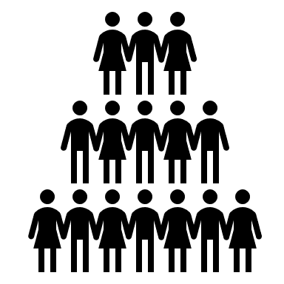
Alcoholism/Alcohol Use Disorder
A person who is alcoholic:
Suffers from a disease
Is not a bad person
Cannot stop drinking
Is more likely to hurt self and abuse others
Needs help to get well

Slide 9
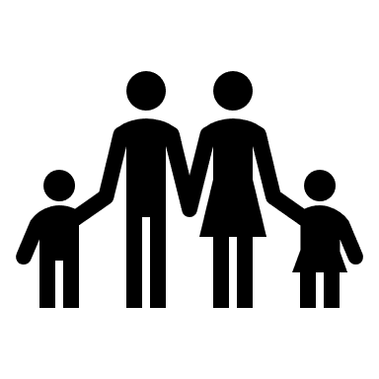
How Alcohol Can Affect Children
Parent may not provide for child
Parent may hurt others in family
Parent may not be able to work
Parent may get in trouble with the law
Child may be embarrassed, angry, sad, afraid
Child may be distracted from schoolwork
Child may need to live with someone else

