Slide 1
Health Products
https://commons.wikimedia.org/wiki/File:Question_mark_1.svg

Slide 2
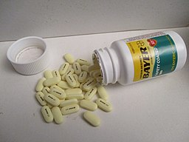
What is the Function of this Product?
1.
https://commons.wikimedia.org/wiki/File:Bayer_Aspirin_Pills.jpg

Slide 3
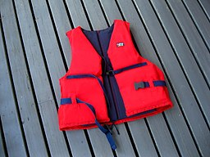
What is the Function of this Product?
2.
https://commons.wikimedia.org/wiki/File:Red_life_jacket.jpg

Slide 4
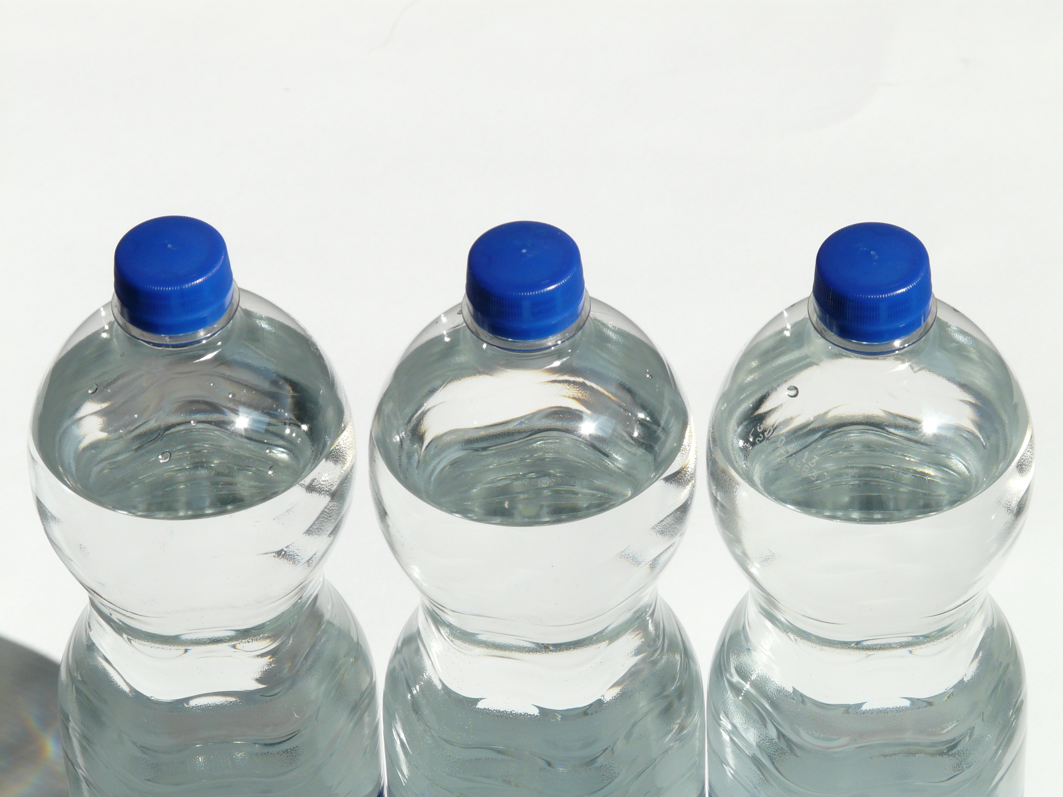
What is the Function of this Product?
3.
https://upload.wikimedia.org/wikipedia/commons/5/51/Water_bottle_blue.jpg

Slide 5
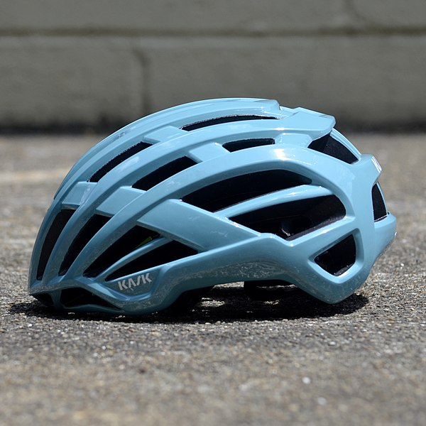
What is the Function of this Product?
4.
https://commons.wikimedia.org/wiki/File:KASK_Helmets_-_48545793602.jpg

Slide 6
What is the Function of this Product?
5.
https://commons.wikimedia.org/wiki/File:BandageWhiteBackground.jpg

Slide 7
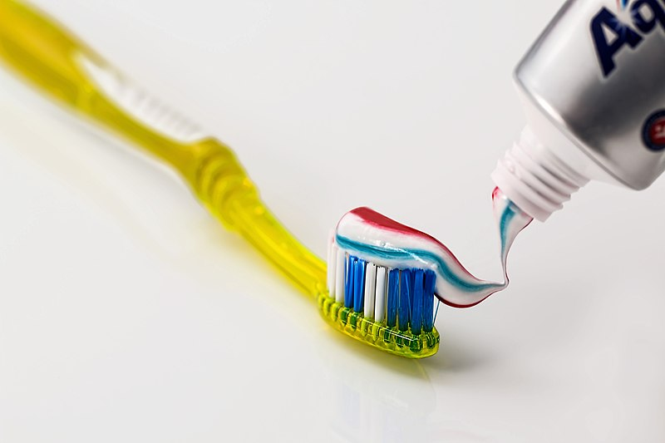
What is the Function of this Product?
6.
https://commons.wikimedia.org/wiki/File:Toothbrush,_Toothpaste,_Dental_Care_(571741).jpg

Slide 8
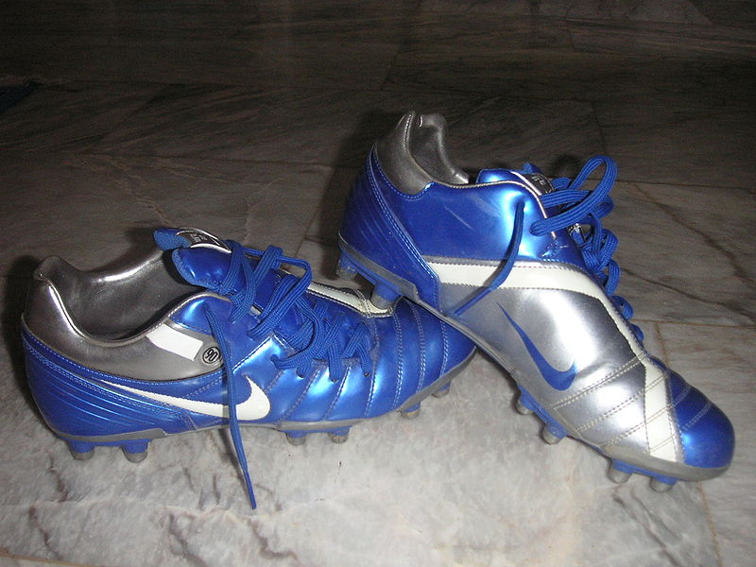
What is the Function of this Product?
7.
https://commons.wikimedia.org/wiki/File:Soccer_shoes.JPG

Slide 9
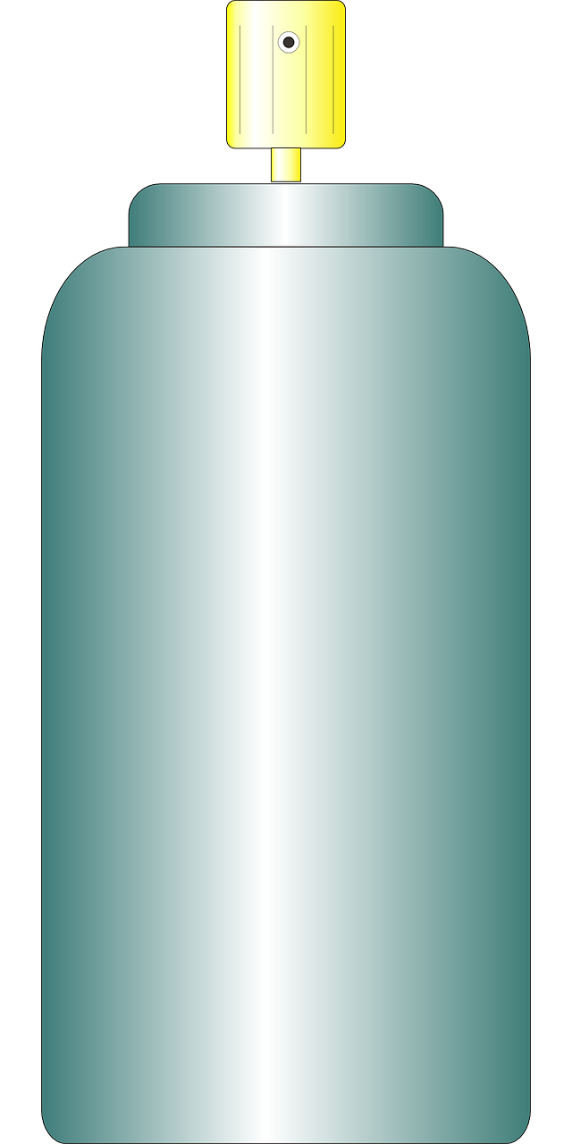
What is the Function of this Product?
8.
Deodorant

Slide 10
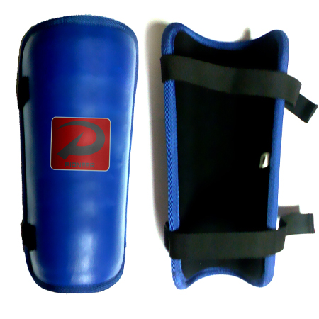
What is the Function of this Product?
9.
https://commons.wikimedia.org/wiki/File:Shinpads.jpg

Slide 11
What is the Function of this Product?
10.
https://commons.wikimedia.org/wiki/File:OFF!_is_an_insect_repellent.jpg

Slide 12
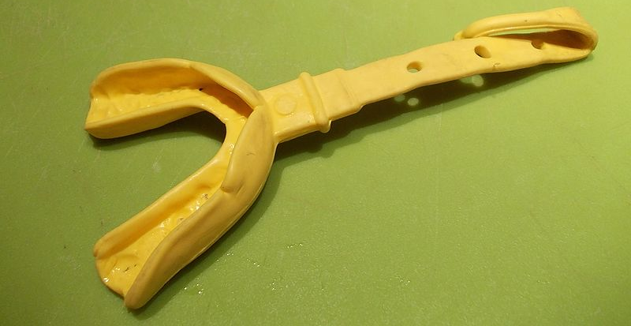
What is the Function of this Product?
11.
https://commons.wikimedia.org/wiki/File:Football_mouthguard.jpg

Slide 13
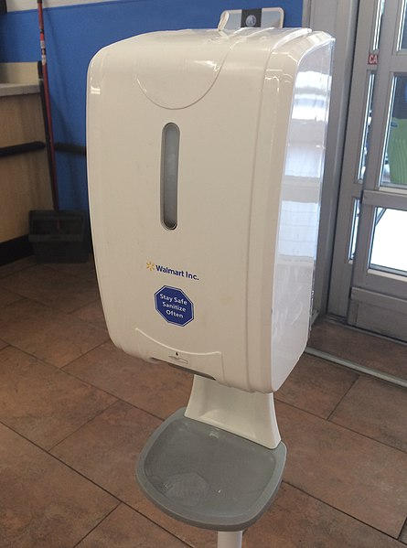
What is the Function of this Product?
12.
https://commons.wikimedia.org/wiki/File:Walmart_Hand_Sanitizer_Dispenser.jpg

Slide 14
Products Use Movies You Like
Go here:
https://www.youtube.com/watch?v=6Qmq0pWstt4

