Slide 1
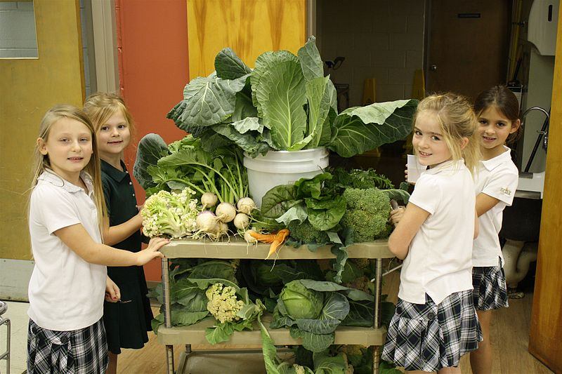
Healthy and Unhealthy Eating Patterns
https://commons.wikimedia.org/wiki/File:Environment_stewardship_photo.JPG

Slide 2
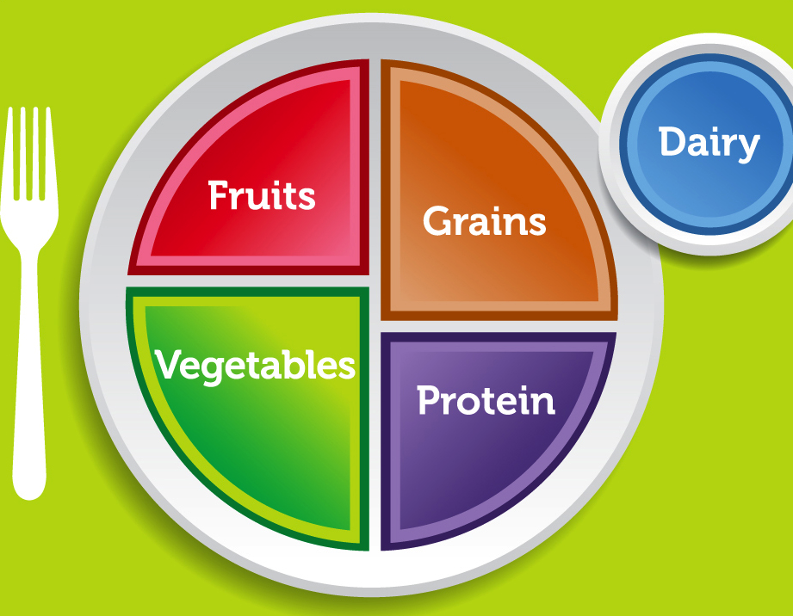
Choose MyPlate
For variety
For nutrient-
dense foods and beverages
For moderation

Slide 3
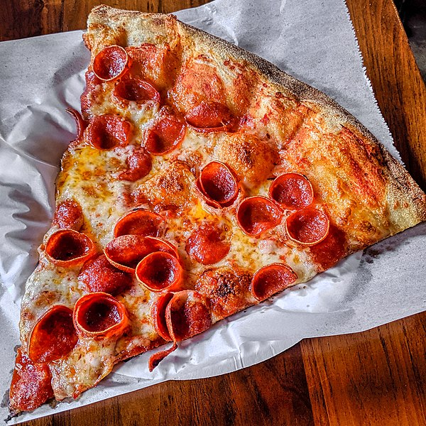
UNHEALTHY Eating Patterns
Being too picky
Limiting foods to just one or two groups
Over-eating less nutrient-dense foods
https://commons.wikimedia.org/wiki/File:Pizza_(48496565362).jpg

Slide 4
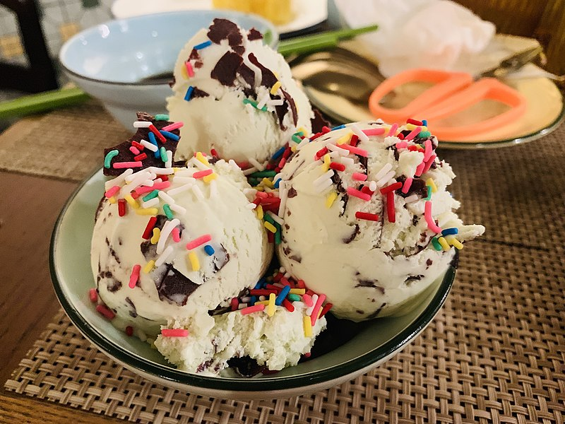
More UNHEALTHY Eating Patterns
Skipping meals
Eating under stress
Eating during other activities, such as watching TV
Too much sugar or salt
https://commons.wikimedia.org/wiki/File:A_mint_chocolate_ice_cream.jpg

Slide 5
Breakfast
Start Smart!
https://www.fns.usda.gov/tn/start-smart-breakfast-video
What were the healthy options? Why?

Slide 6
Why Breakfast IS the Most Important Meal of the Day
Provides energy
Improves memory and recall
Helps with weight control
Prevents snacking on less nutritious foods
Helps concentration
Prevents mid-morning “slump”
Helps us get nutrients we need
Tastes great
Do better with school

Slide 7
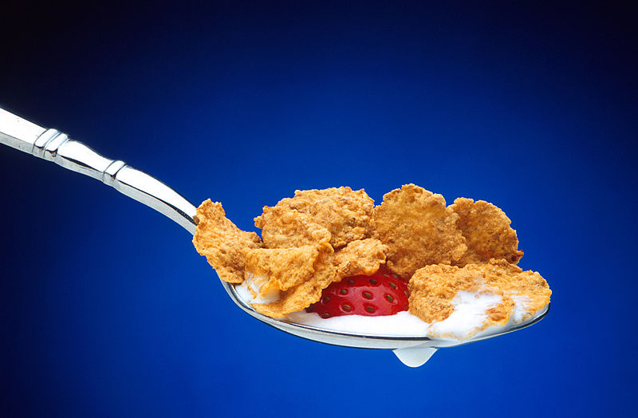
Skipping Breakfast? Bad Idea!
Breakfast skippers tend to be overweight more than those who eat a good breakfast.
Breakfast eaters make healthier choices throughout the day.
https://commons.wikimedia.org/wiki/File:Spoonful_of_cereal.jpg

Slide 8
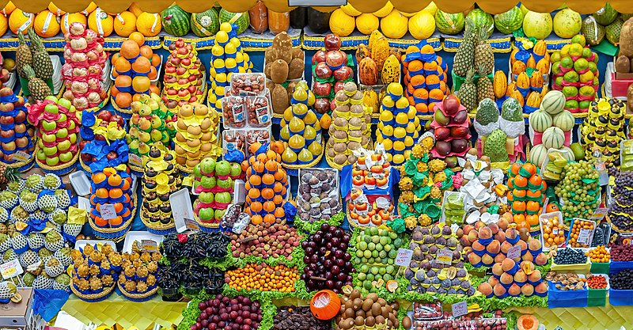
Variety and Nutrient-Dense
Eat foods that have more vitamins and minerals and less fat, sugar, salt.
Eat foods from at least 3 of the food groups.
https://commons.wikimedia.org/wiki/File:Municipal_Market_of_S%C3%A3o_Paulo_city.jpg

Slide 9
Why Lunch is Important TOO
Re-energizes the body
Reduces binge eating and non-nutritious snacking
Keeps blood sugar at the right level
Helps with weight control
Helps concentration
Prevents afternoon “slump”
Helps us get nutrients we need
Tastes great
Do better with school

Slide 10
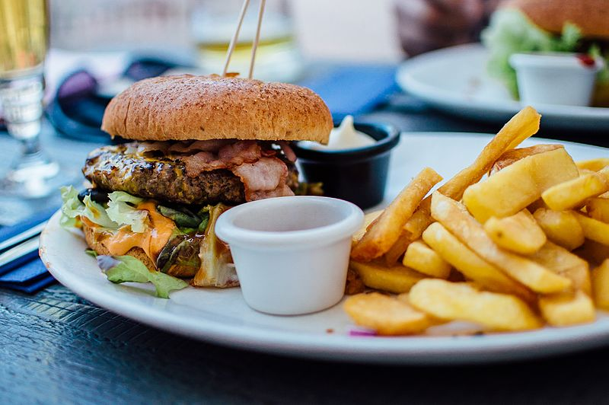
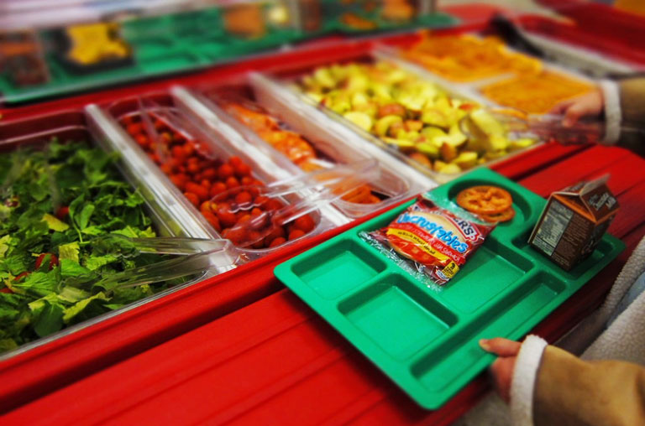
Which is the More Nutrient-Dense Lunch?
A.
B.

Slide 11
Crack the secret code!
Work with a partner and complete the handout to share what you’ve learned about food and nutrient density.
Volunteers for
answers

Slide 12
“Occasional” Foods
Foods higher in fat, calories, sugar, salt
Okay to eat every once in a while
https://commons.wikimedia.org/wiki/File:Pink_Cupcakes.jpg

Slide 13
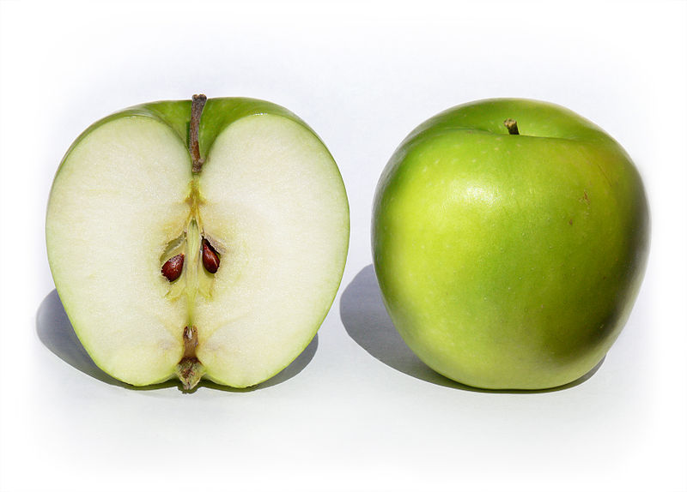
Nutritious Breakfast and Lunch = Healthy and FUN!
https://commons.wikimedia.org/wiki/File:Granny_Smith_Apples.jpg

