Slide 1
Essential Question: Why is it important to be able to understand and identify the changes that occur during puberty? How can this knowledge assist you when interacting with others near your age?

Slide 2
Puberty
When your body begins to change and grow.

Slide 3
Puberty happens to everyone
When???
8-13 females
9-15 males

Slide 4
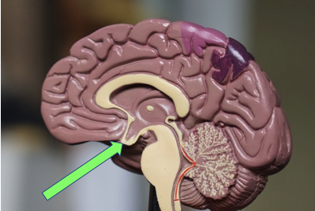
Where does it begin?? Pituitary Gland

Slide 5
Physical Changes for Males and Females
Sweat glands more active
Oil glands more active
Hair growth
Growth spurts
Video - Taking care of your body

Slide 6
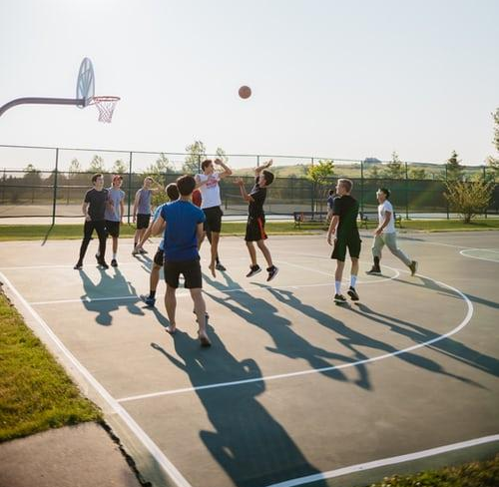
Physical Changes for Males
Shoulders widen
Increased height & weight
Facial hair
Voice deepens
Penis and testicles grow
Spontaneous erections & Nocturnal emissions
Video - Nocturnal Emission

Slide 7
Physical Changes for Females
Early Changes
Increased height & weight
Breast buds
Pubic and underarm hair growth
Late Changes
Hips widen
Ovulation/menstruation
Video - Menstruation

Slide 8
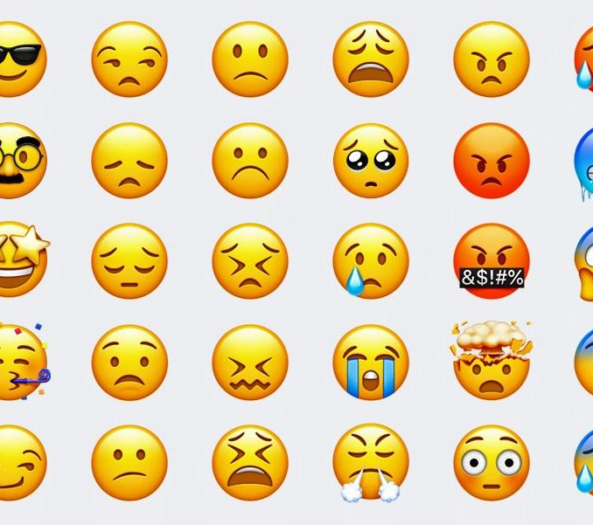
Emotional/Social Changes
Mood swings
Easily embarrassed
Fragile self-esteem
Friends become more important
More competitive
Unsure of self
Needs reassurance
Video - Sad and Happy Feelings

Slide 9
Maturing Early vs. Late
Thumbs up if you think this is an advantage of maturing early or late.
Thumbs down if you think this is a disadvantage of maturing early or late

Slide 10
Puberty is survivable
Puberty happens to everyone
It is normal

Slide 11
Identify a trusted adult
Talk about what to expect
Identify the physical and emotional changes in yourself
Talk about what you are experiencing

Slide 12
Empathy
Support your friends
Put yourself in their shoes
Compassion and understanding makes this transition easier!

Slide 13
Advocacy
Puberty is unpredictable
Everyone will go through puberty
Everyone is insecure about their bodies and emotions when going through puberty
Do not contribute to a peer's insecurity
See something, say something

