Slide 1
Essential Question: Why is it important to be able to distinguish between a healthy and unhealthy relationship? How can you make friendships stronger even when there are differences?

Slide 2
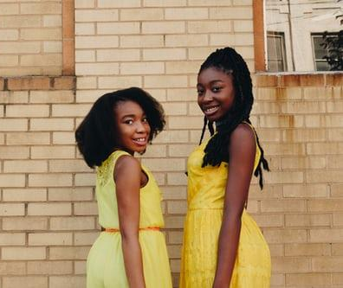
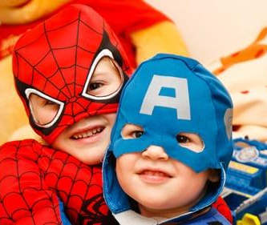
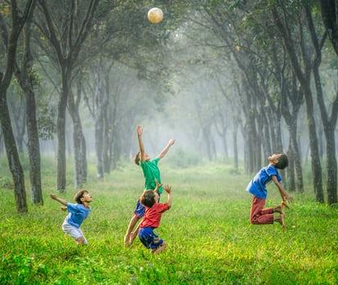
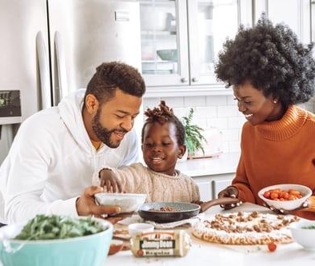
Healthy Relationships

Slide 3
Brainstorm
Characteristics of Healthy Relationships

Slide 4
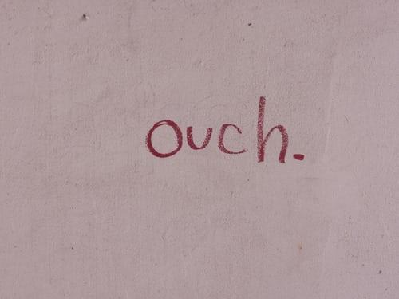
Unhealthy Relationships

Slide 5
Brainstorm
Characteristics of Unhealthy Relationships

Slide 6
How do influences impact our relationships?

Slide 7
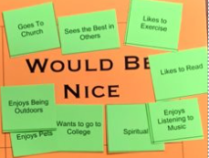
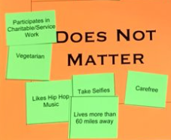
What about the characteristics classified as "Would Be Nice" or "Does Not Matter"?

Slide 8
Analyzing Influences

Slide 10
Analyze the Influence
Hold up the GREEN card if you think the situation demonstrates healthy relationship characteristics and will influence the relationship in a positive way.
Hold up the RED card if you think the situation demonstrates unhealthy relationship characteristics and will influence the relationship in a negative way.

Slide 11
Jennah came to school on the first day wearing her hijab. Students in her class did not understand the meaning of it and began making fun of her.
Unhealthy – these students are being disrespectful of Jennah's religion.

Slide 12
Jennah came to school on the first day wearing her hijab. Students in her class did not understand the meaning of it and began making fun of her. Xavier, another student in the class stood up and told them to be quiet! They stated that a hijab is a head covering worn in Jennah’s religion. Xavier, asked his classmates how would they feel if someone made fun the cross they wear on a chain around their neck?
Healthy – Xavier showed integrity, empathy, and religious understanding

Slide 13
Ty was invited to see the new Marvel movie with his buddies but instead he went to his little brother’s basketball game to cheer him on like he promised.
Healthy – Ty knows his little brother looks up to him and he wants to be a good role model for him.

Slide 14
During lunch at school one day Victoria was talking to her friends about a new video game she had been playing. Her friends were shocked and told her that it is so weird that she plays video games. They said she should do normal girl things instead.
Unhealthy – Victoria's friends are being judgmental and not embracing her individuality

Slide 15
Riley loves to paint and draw. They are very proud of their works, but doesn't like showing them off. Their friend Sarah is always giving high praise for their works and supported Riley’s decision when Riley decided to submit artwork to a contest.
Healthy - Sarah is proud of Riley supported their decision without pressuring Riley to do something they were not ready for.

