Slide 1
What food is this?
Ingredients 5 cups all-purpose flour, divided 1 cup Grated Parmesan Cheese 1 teaspoon fast-rising dry yeast ½ teaspoon salt 2 cups cold water ¼ cup olive oil ½ cup Tomato Sauce 1 can Diced Tomatoes, drained 2 cups Shredded Mozzarella Cheese 10 slices Pepperoni Directions Mix 4 cups flour, 1 cup Parmesan, yeast and salt in large bowl. Add water and oil; stir until mixture forms soft dough. Knead on lightly floured surface 5 minutes or until smooth and elastic, gradually adding remaining flour. Cut dough into 4 pieces. Spray 1 dough piece with cooking spray; cover loosely with plastic wrap. Let stand 15 minutes. See tip for how to store remaining dough for another use. Heat oven to 400°F. Roll 1 dough piece (after standing 15 minutes) into 12-inch round on lightly floured surface; place on pan. Bake 6 minutes. Top with tomato sauce, drained tomatoes, mozzarella, and pepperoni. Bake 15 minutes or until mozzarella is melted and edge of crust is golden brown. Cut into slices.

Slide 2
Pepperoni Pizza

Slide 3
Where does our food come from?
3.NPA.2.1
Identify the sources of a variety of foods

Slide 4
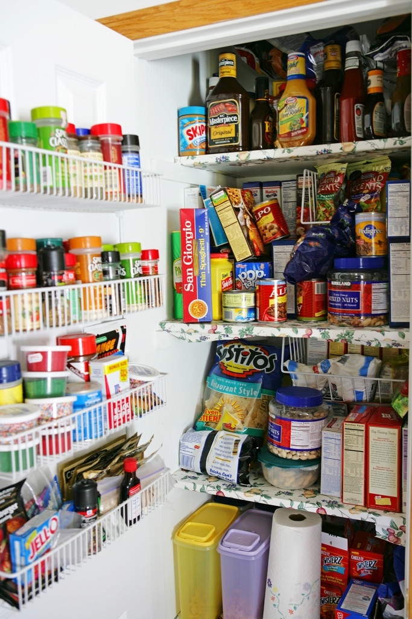
Objectives
List the common sources of foods.
Match foods with their sources.
Describe the variety of foods available from these sources.

Slide 5
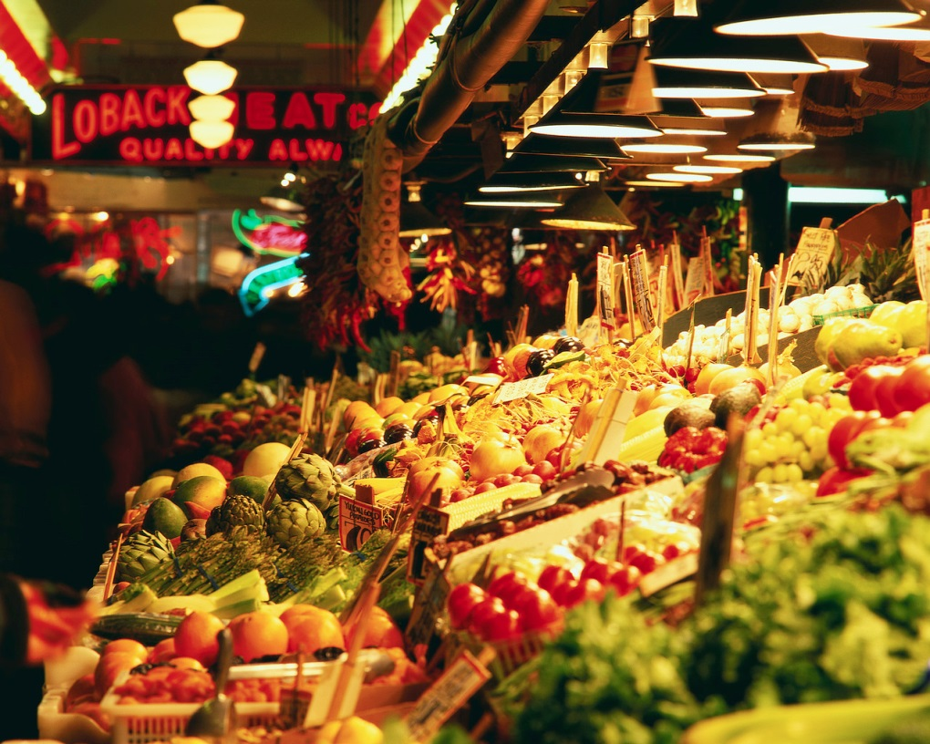
Where do you get your food?
Grocery store
Super market
Other stores
Famer’s market
School
Home/other garden
Restaurants

Slide 6
But food really comes from…
the Earth

Slide 7
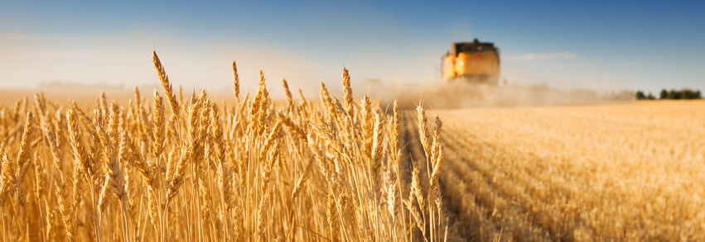
Sources of Food
farms, ranches, the ocean, rivers/lakes, groves, and orchards

Slide 8
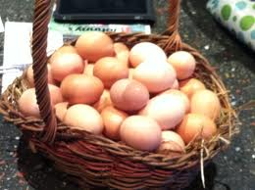
Common Foods from Farms
eggs
wheat
corn
tomatoes
squash
asparagus
beets
okra
milk
peas
cucumber
onions
cheese
Can you think of others?

Slide 9
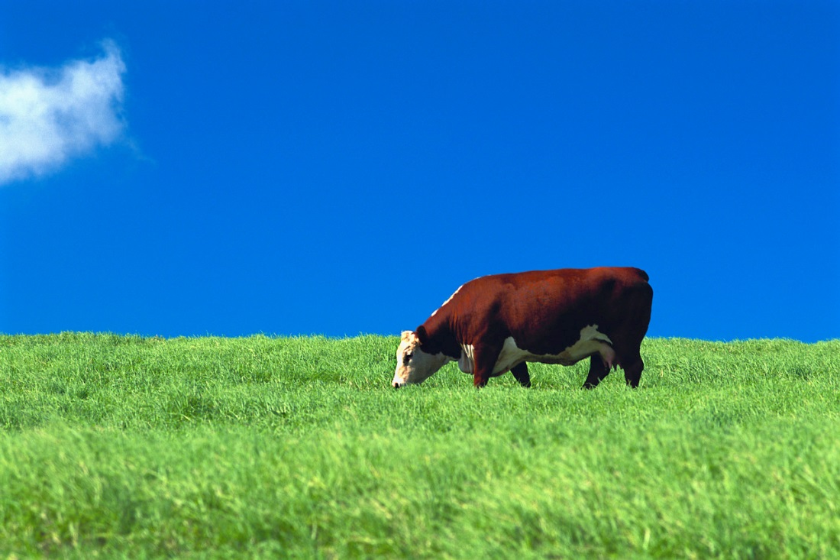
Common Foods from Ranches
Can you think of others?
beef
pork
chicken
turkey

Slide 10
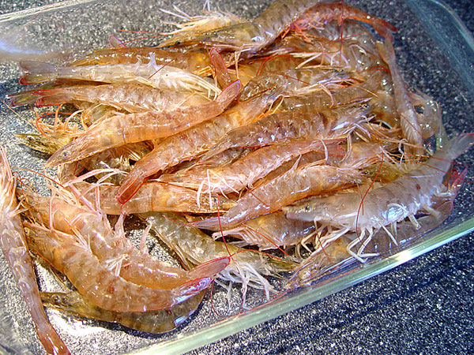
Common Foods from Oceans, Rivers and Lakes
shrimp
oysters
tilapia
salmon
clams
trout
scallops
perch
bass
cod
crab
catfish
tuna
squid
Can you think of others?

Slide 11
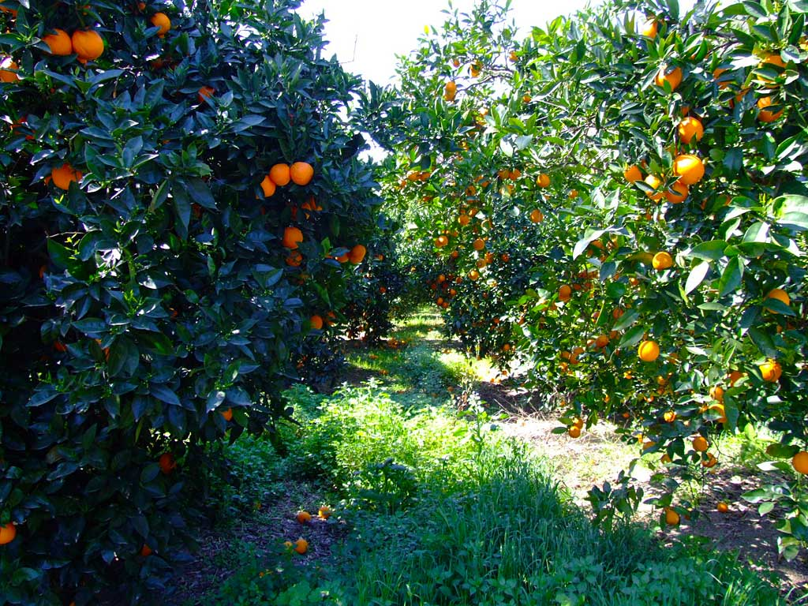
Common Foods from Groves and Orchards
Can you think of others?
oranges
apples
pineapple
bananas
berries
grapes
olives

Slide 12
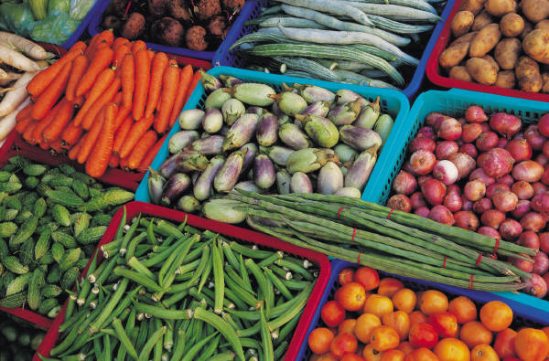
Why should you know where your food comes from?
Less processed foods tend to be healthier. That means eating fruits and vegetables in their original state!
What’s missing in these sources?
Candy, soda and chips---less healthy choices.

Slide 13
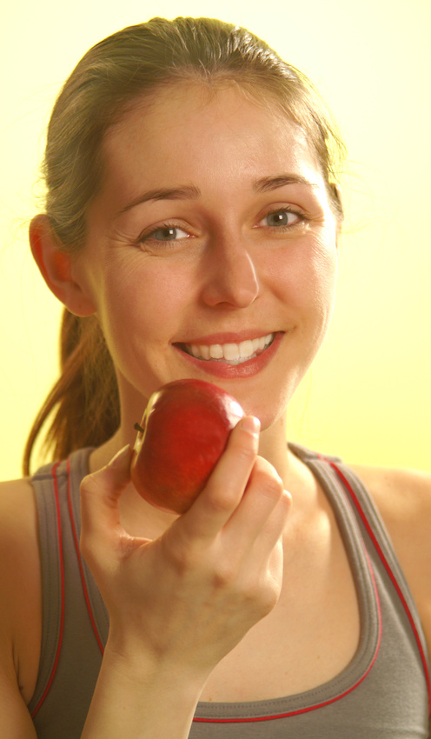
Questions?

