Slide 1
Where Does it Come From?

Slide 2
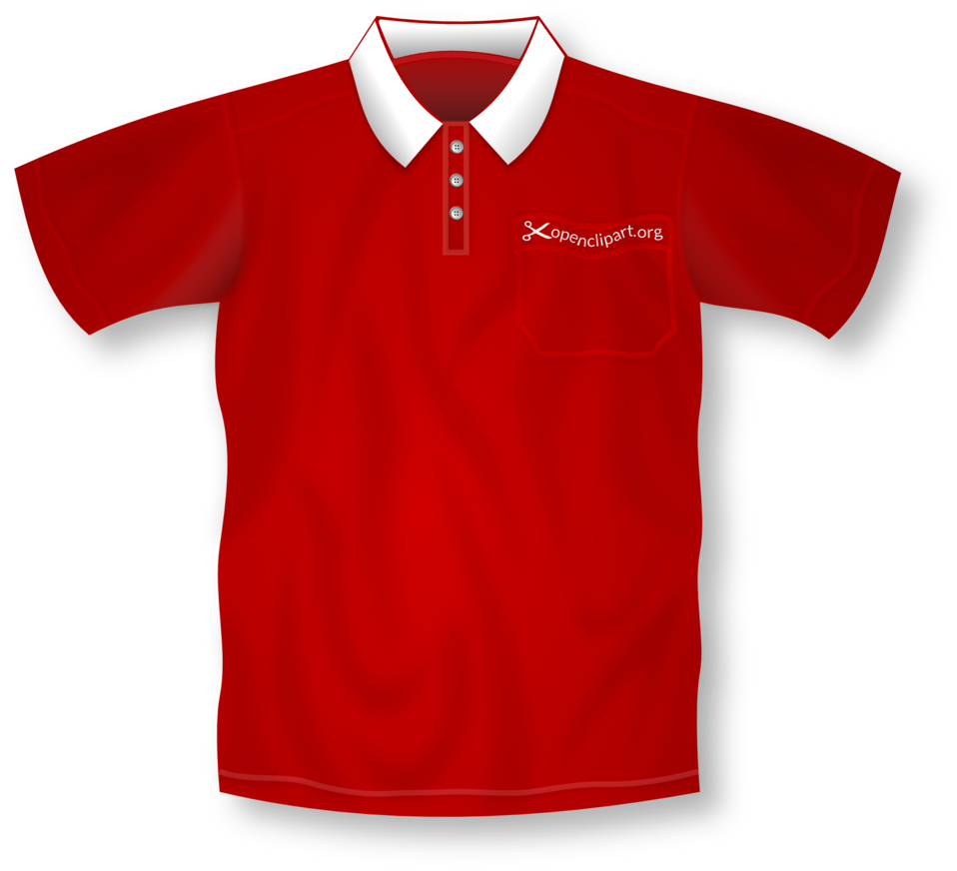
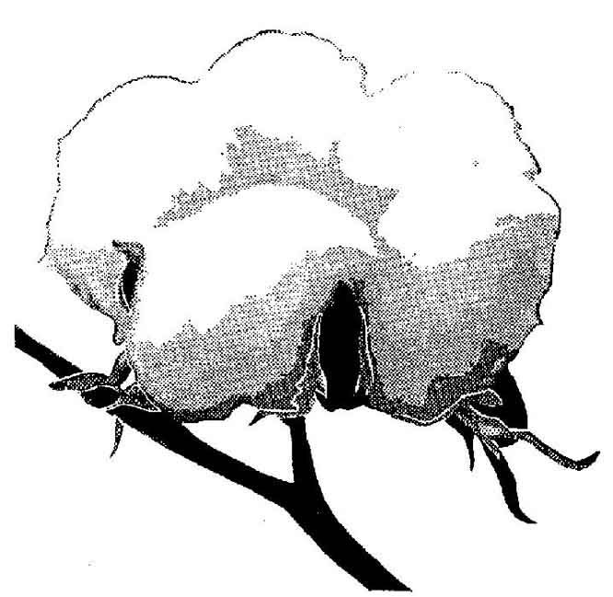
What are some clothes made from?

Slide 3
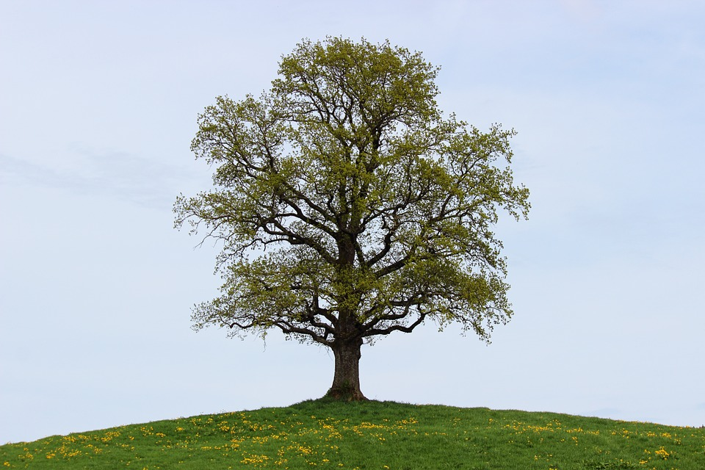
What is paper made from?

Slide 4
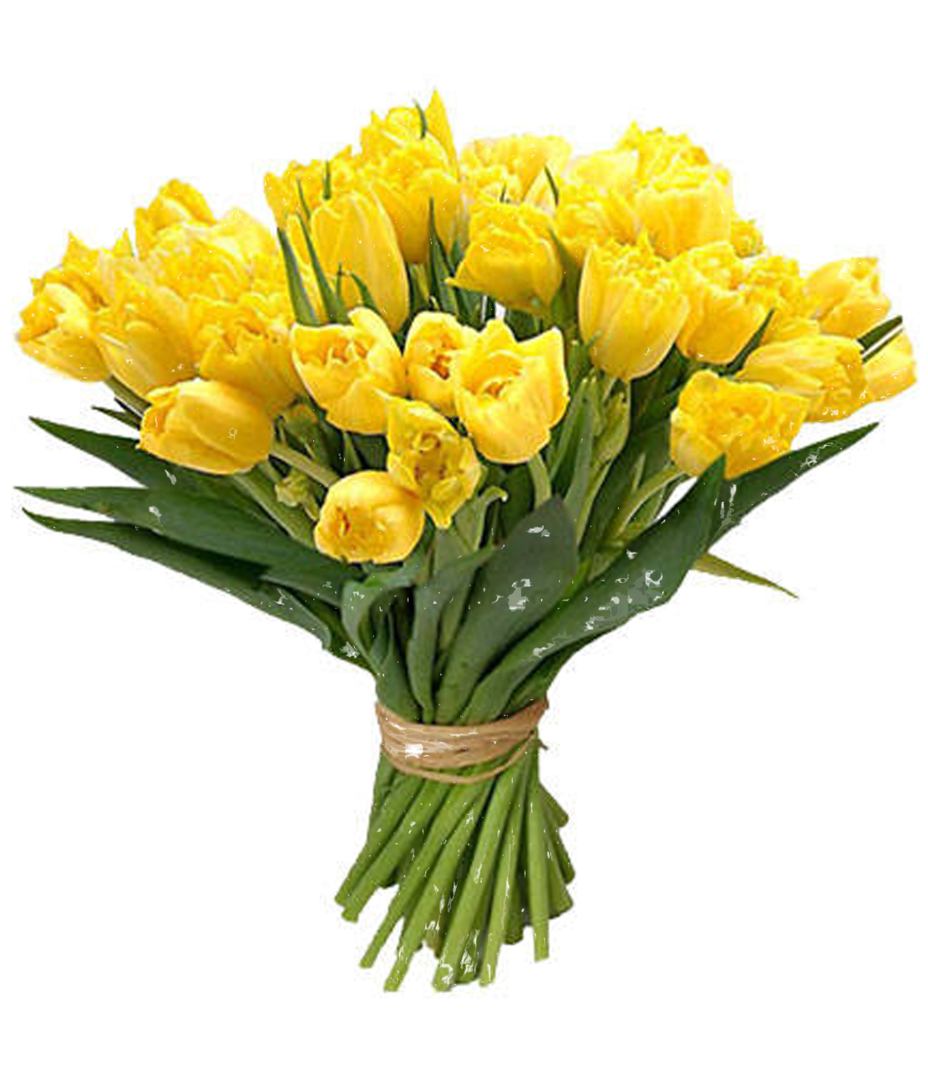
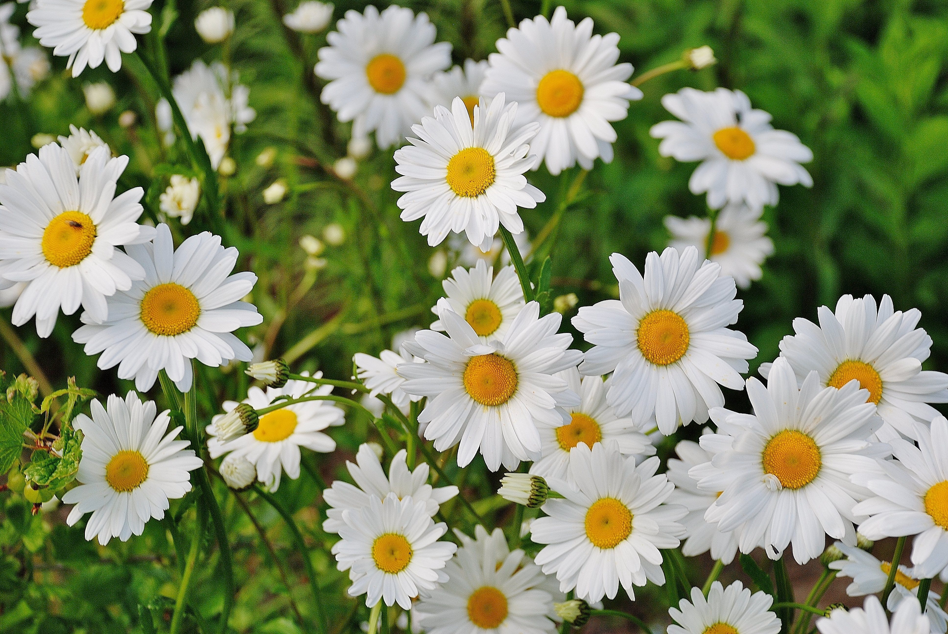
Where do flowers come from?

Slide 5
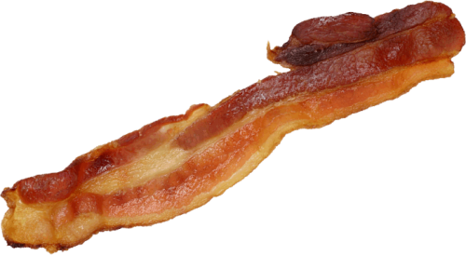
From a Plant or an Animal?

Slide 6
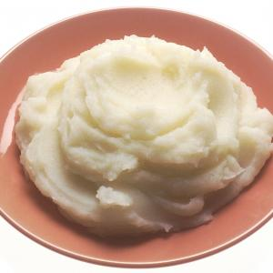
From a Plant or an Animal?

Slide 7
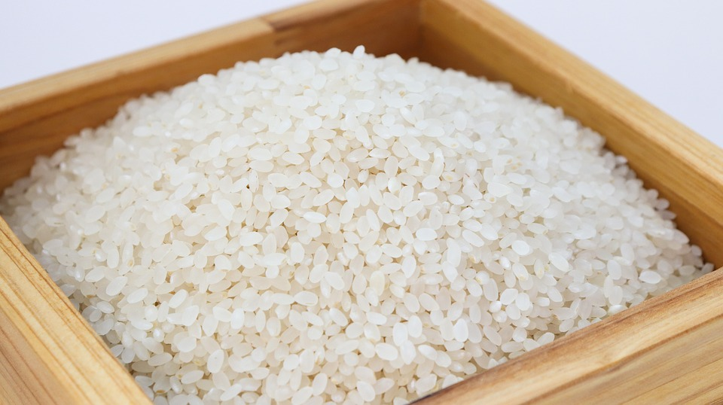
From a Plant or an Animal?

Slide 8
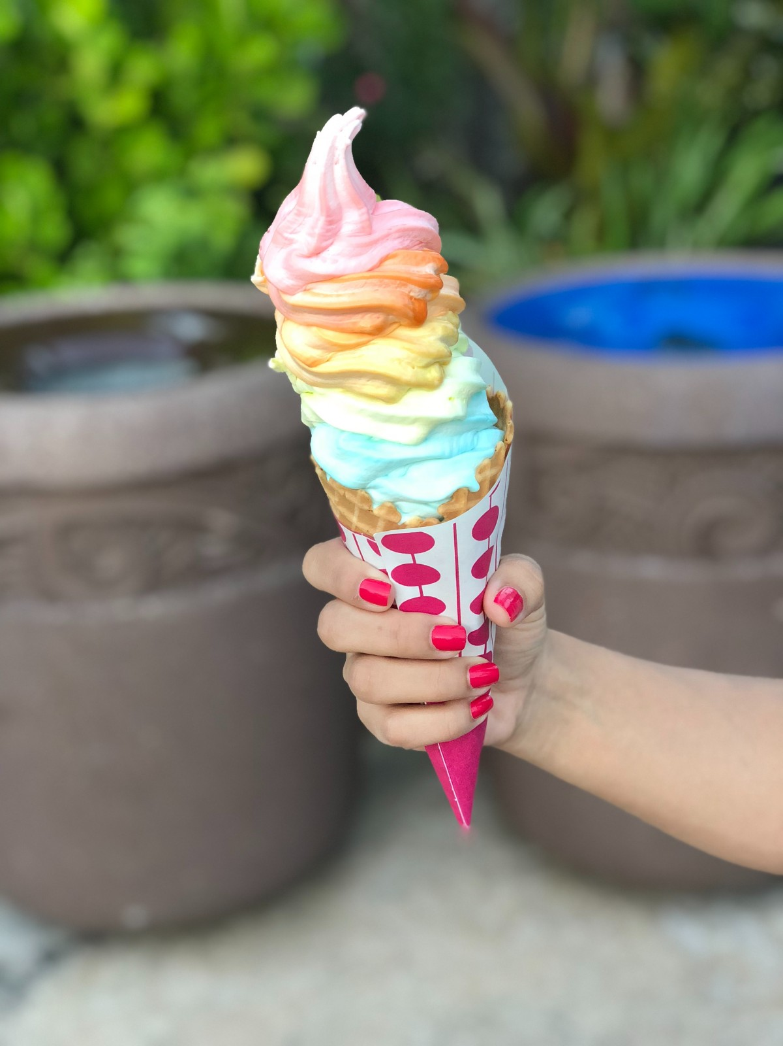
From a Plant or an Animal?

Slide 9
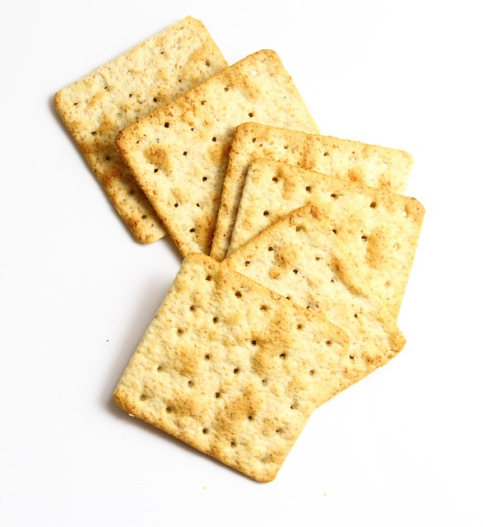
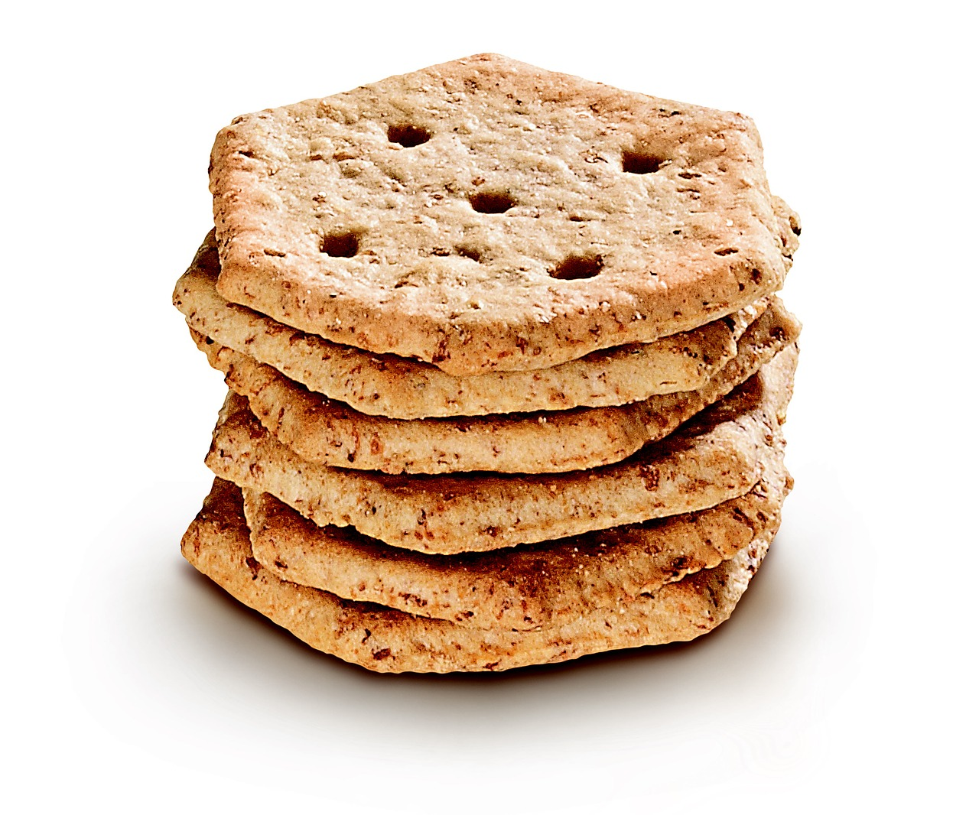
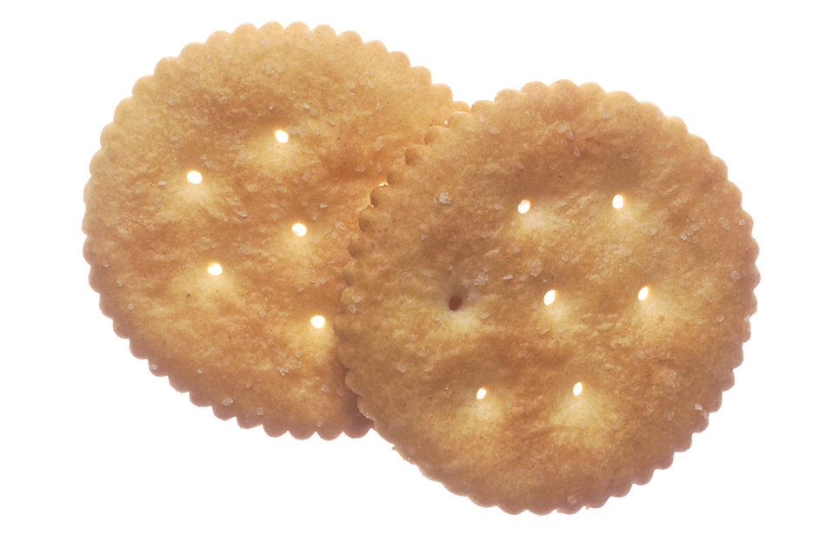
From a Plant or an Animal?

Slide 10
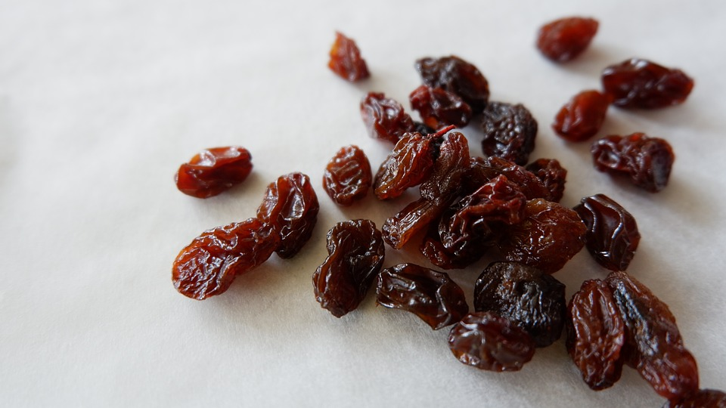
From a Plant or an Animal?

Slide 11
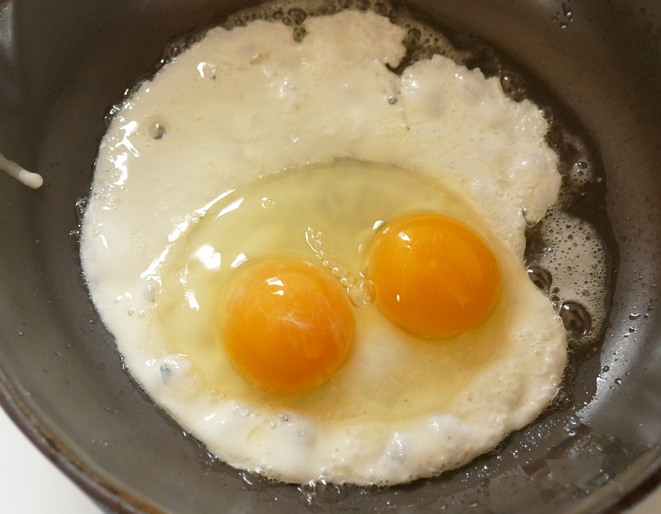
From a Plant or an Animal?

Slide 12
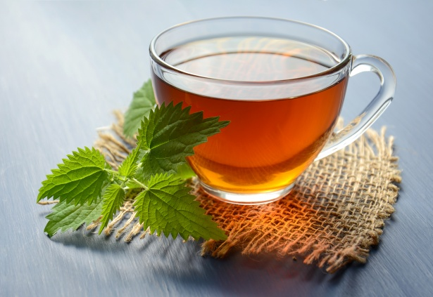
From a Plant or an Animal?

Slide 13
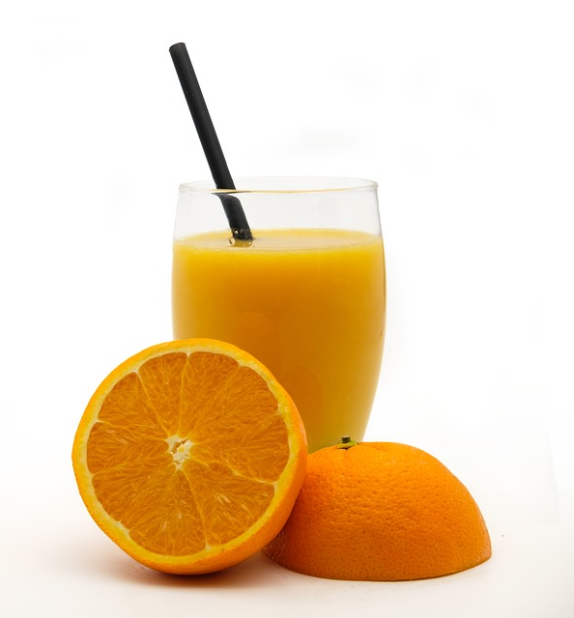
From a Plant or an Animal?

Slide 14
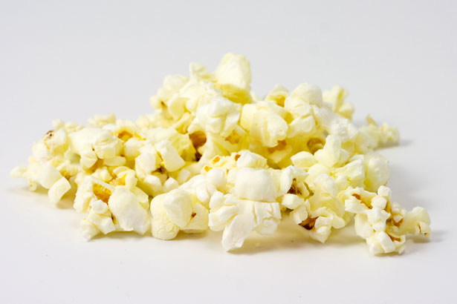
From a Plant or an Animal?

Slide 15
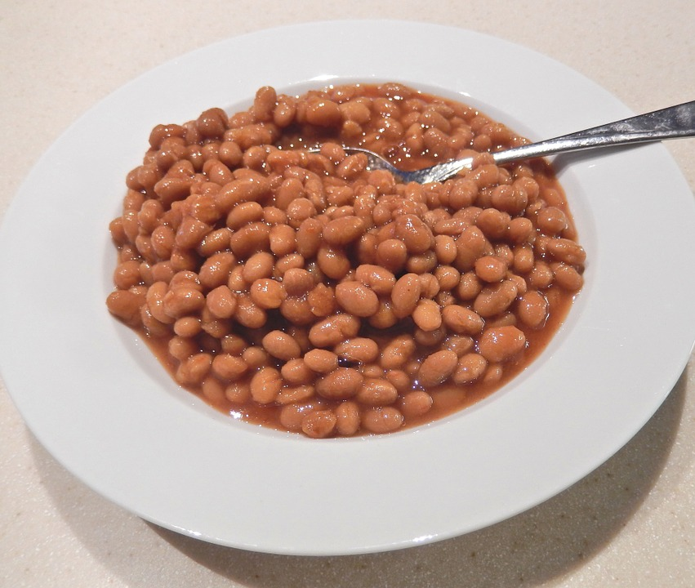
From a Plant or an Animal?

Slide 16
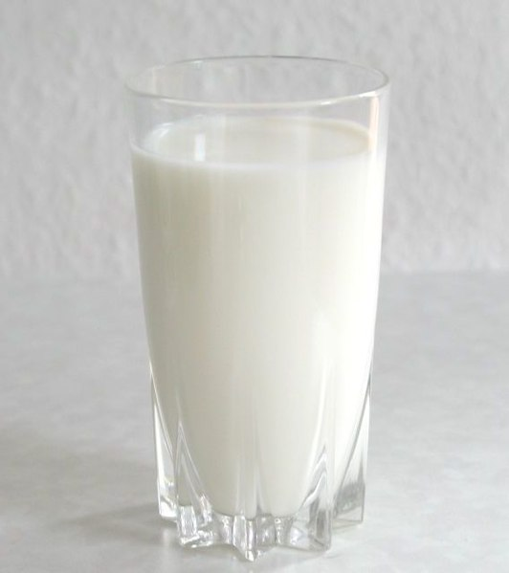
From a Plant or an Animal?

Slide 17
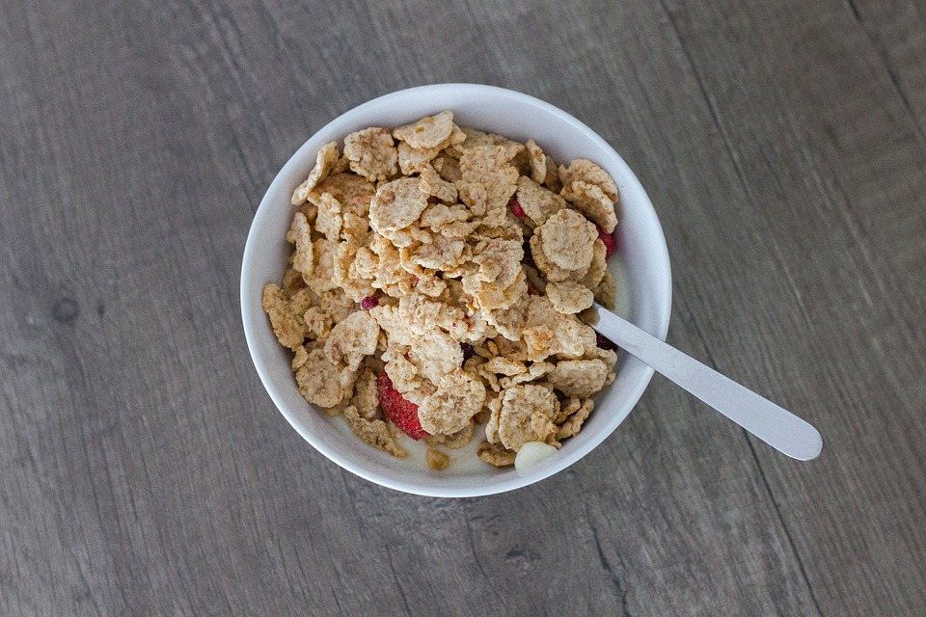
From a Plant or an Animal?

Slide 18
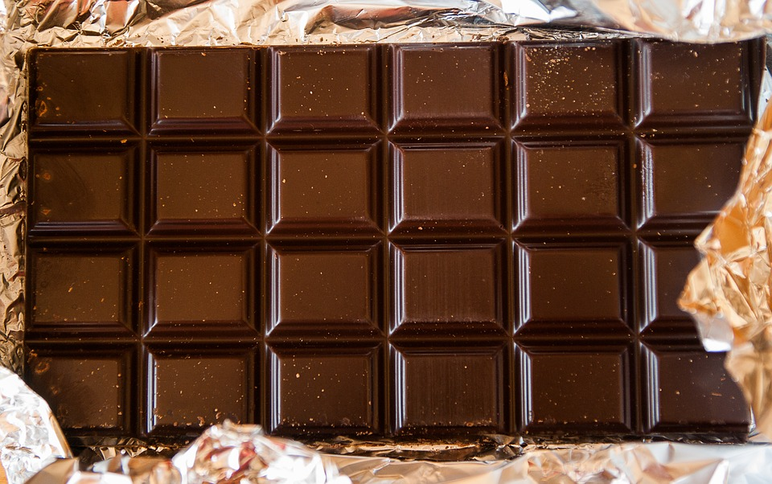
From a Plant or an Animal?

Slide 19
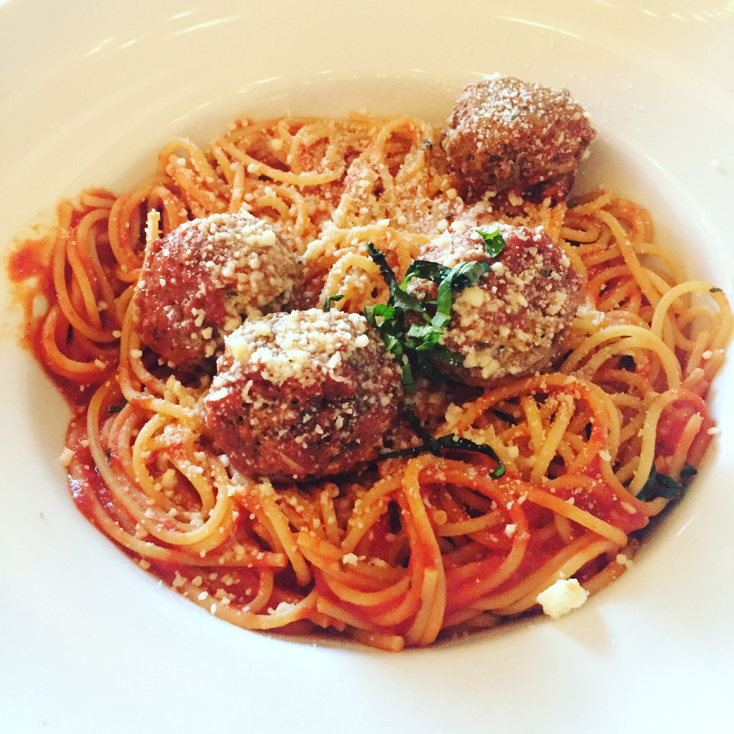
From a Plant or an Animal?

