Slide 1
Choose This Not That

Slide 2
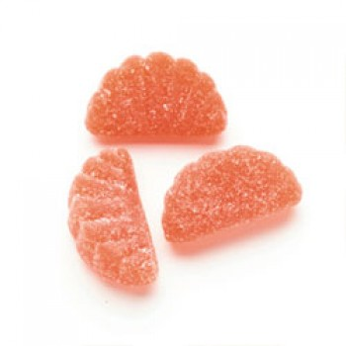
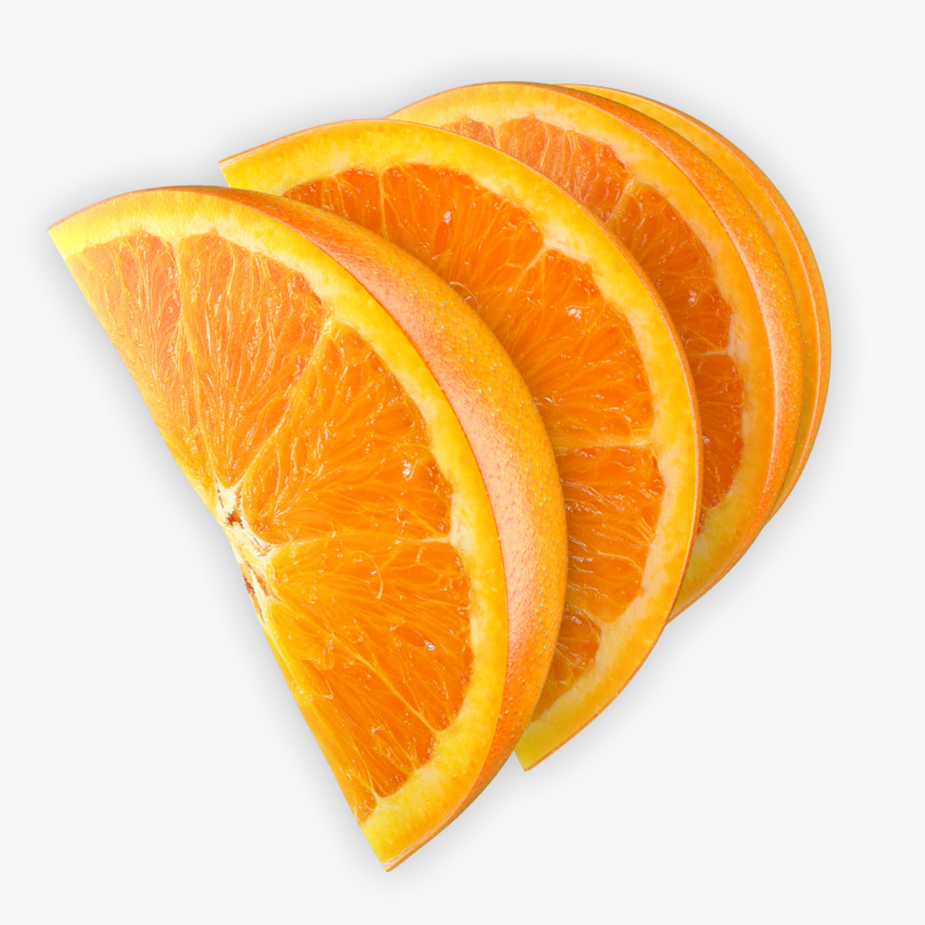
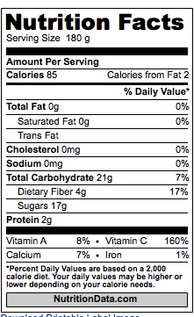
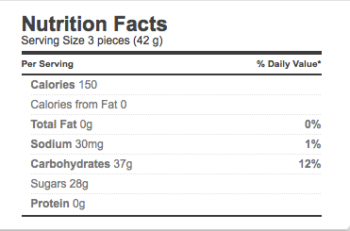
Compare
Fresh
Orange
Slices
Candy
Orange Slices
No Vitamins or Fiber

Slide 3
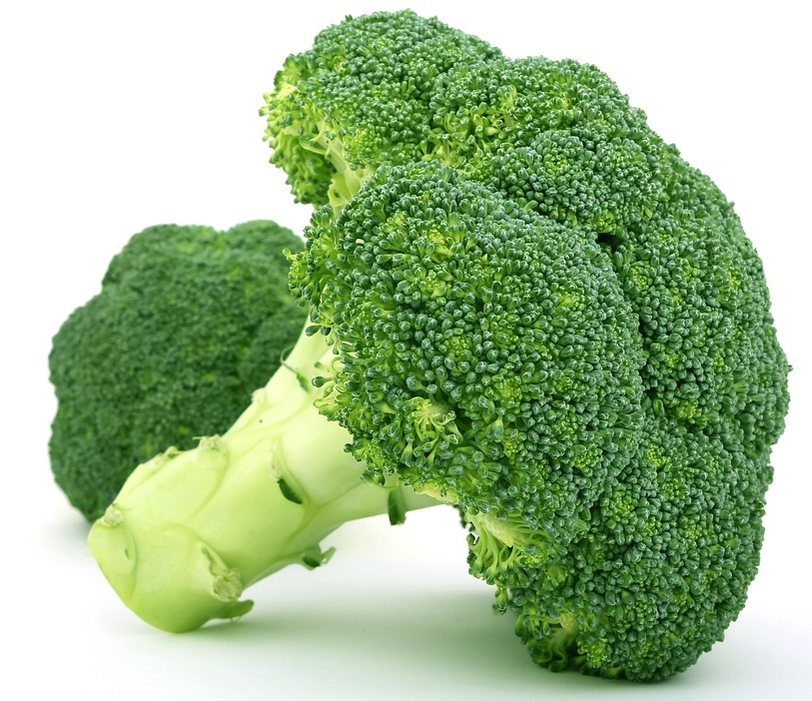
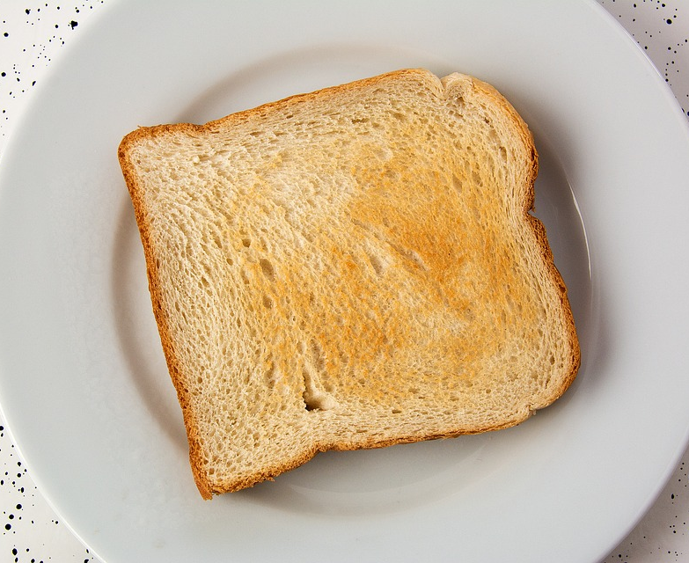
Which One Is Nutrient Dense?
Broccoli
White Bread

Slide 4
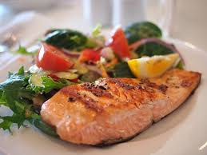
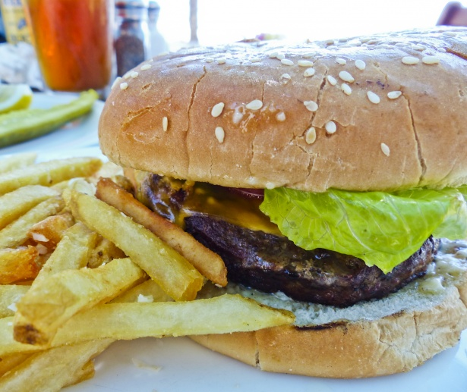
Which One Is Nutrient Dense?
Salmon
Hamburger

Slide 5
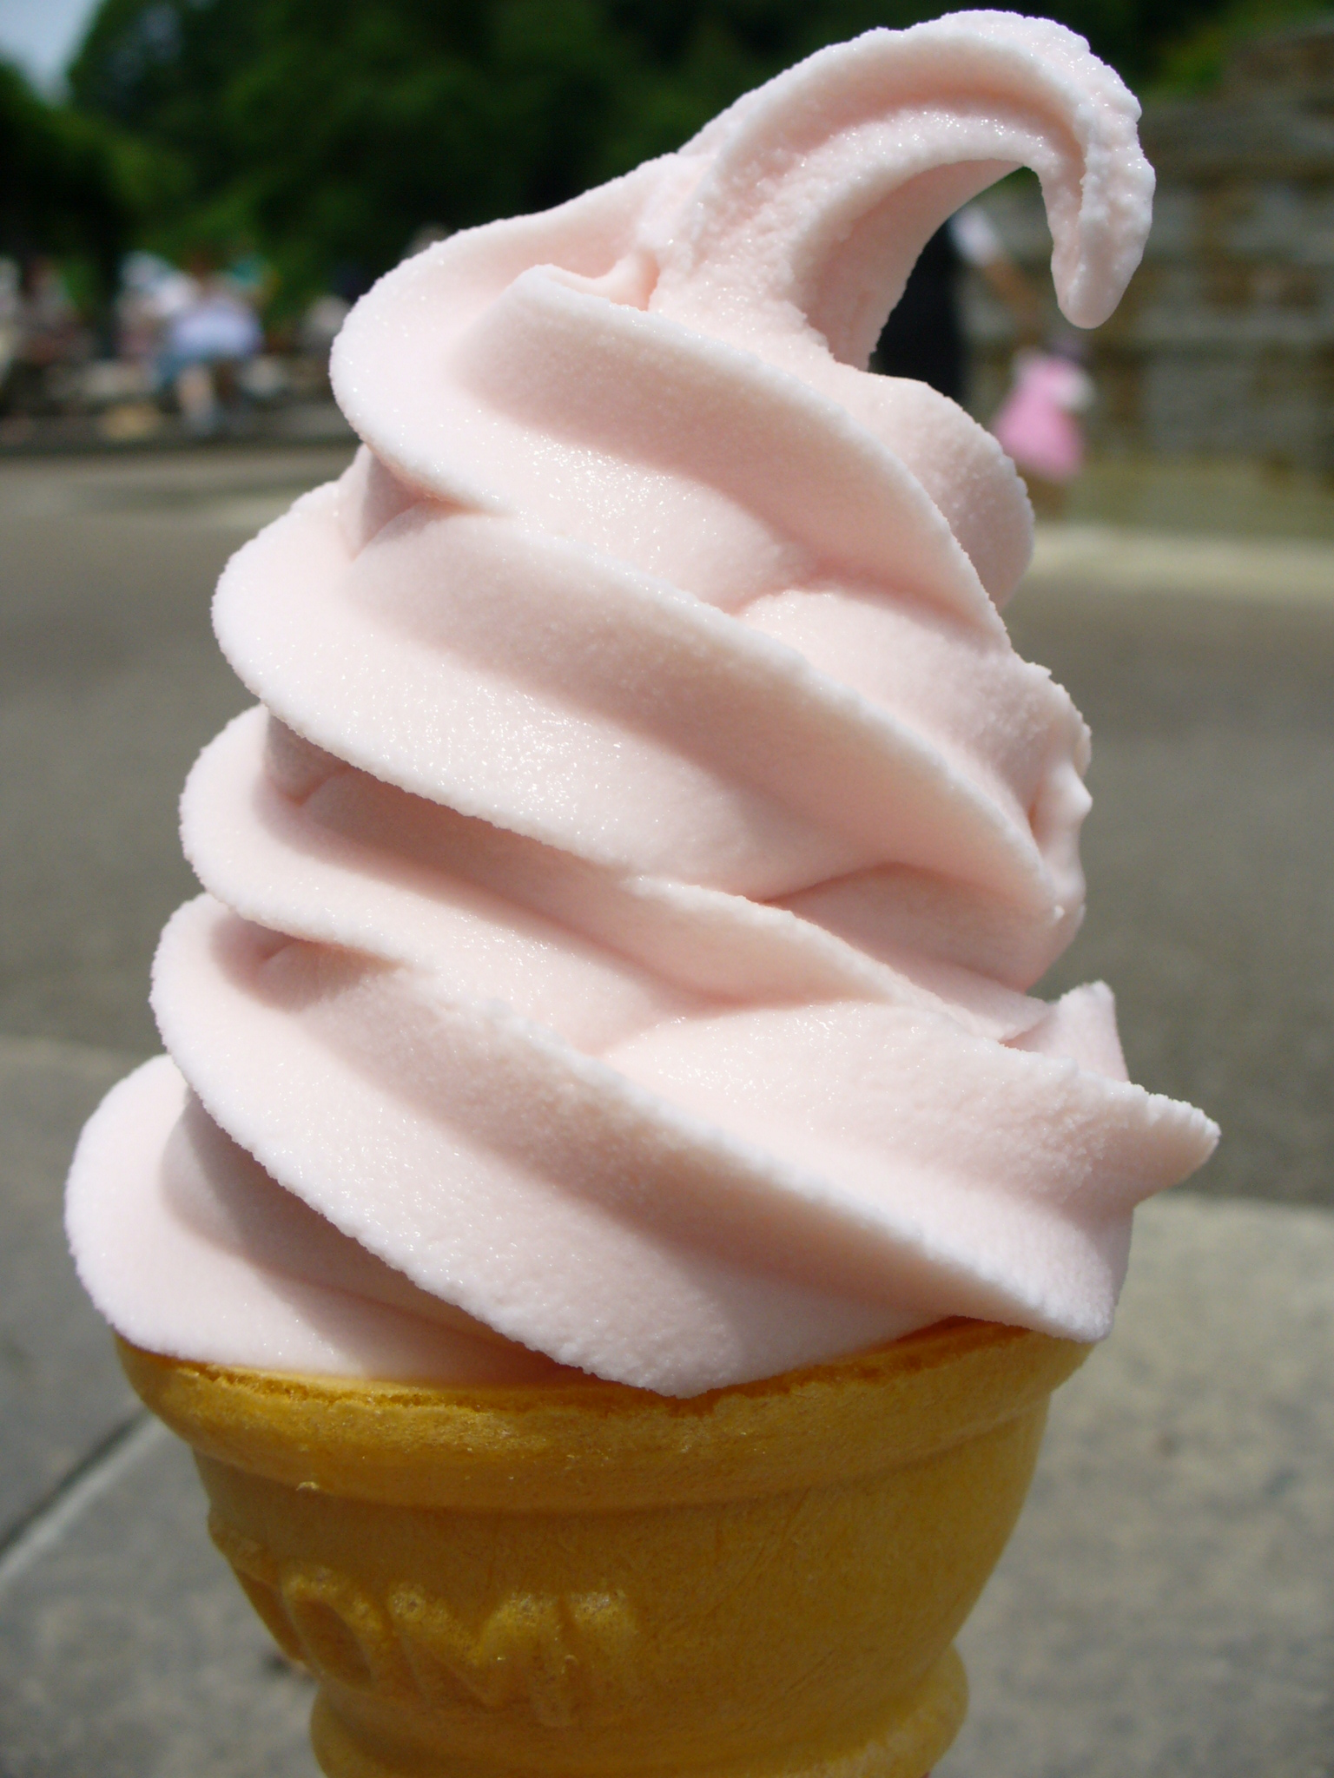
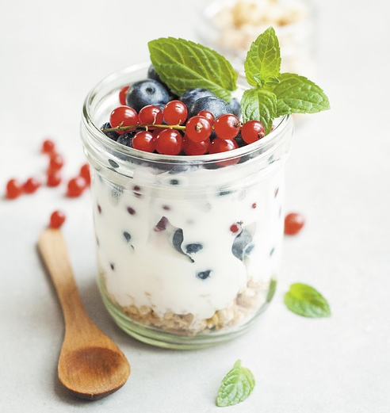
Which One Is Nutrient Dense?
Ice Cream
Yogurt

Slide 6
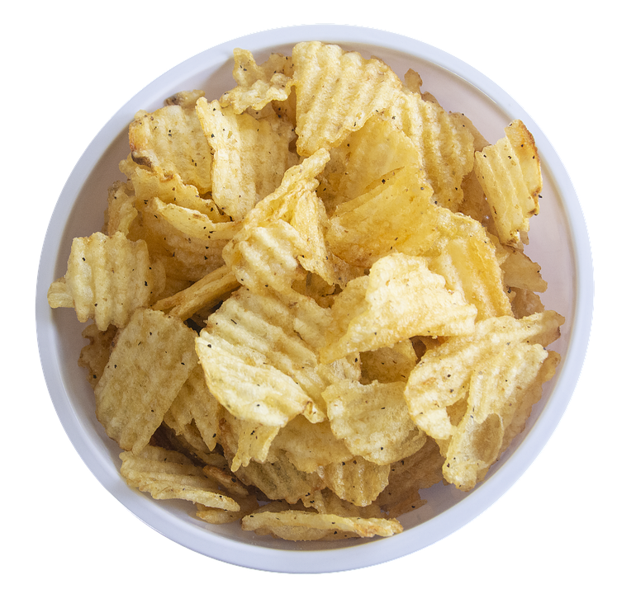
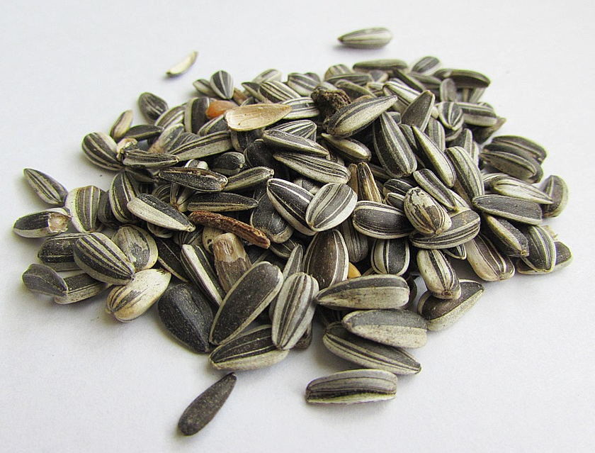
Which One Is Nutrient Dense?
Potato Chips
Sunflower Seeds

Slide 7
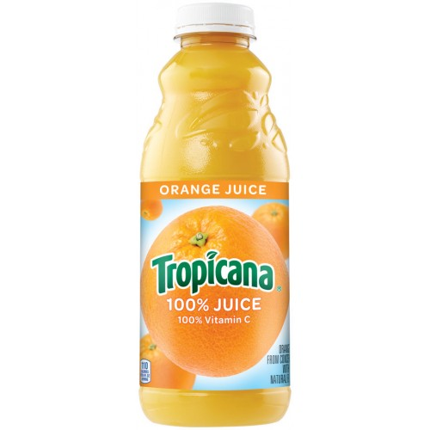
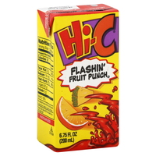
Which One Has the Least Sugar?
100% Orange Juice
Fruit Drink Box

Slide 8
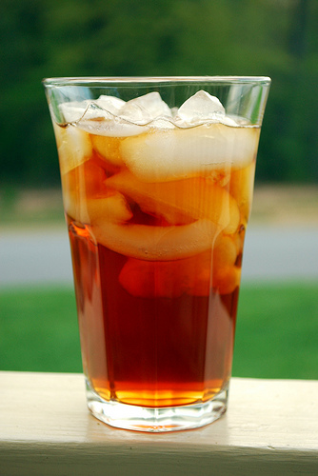
Which One Has the Least Sugar?
Sweet Tea
Unsweetened Tea

Slide 9
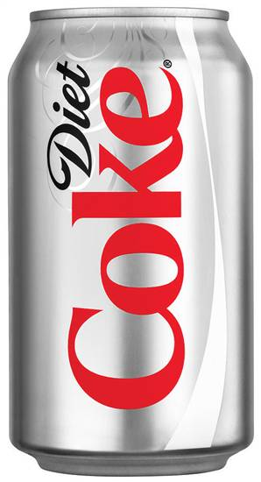
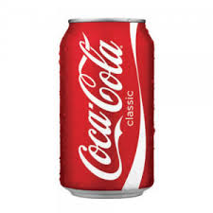
Which One Has the Least Sugar?
Diet Soda
Soda

Slide 10
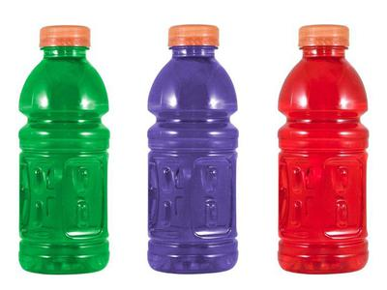
Which One Is the Best Option?
Water
Sports Drink

