Slide 1
Positive and Negative Stressor

Slide 2
Riding a Bike Without Training Wheels for the First Time

Slide 3
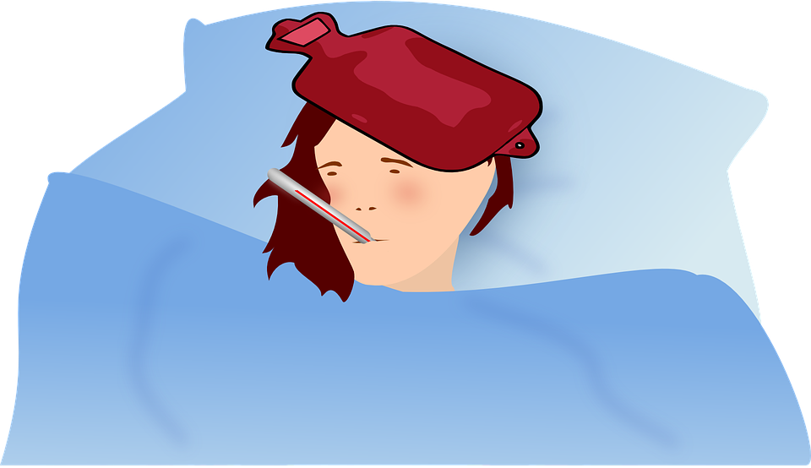
When Mom or Dad is Sick

Slide 4
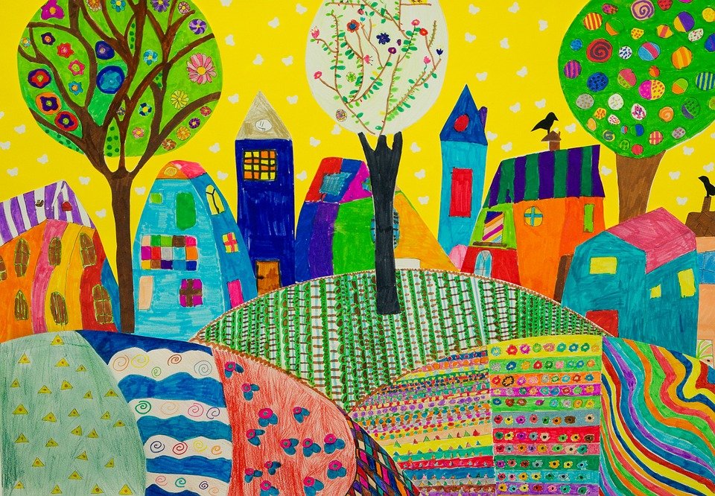
Participating in an Art Contest

Slide 5
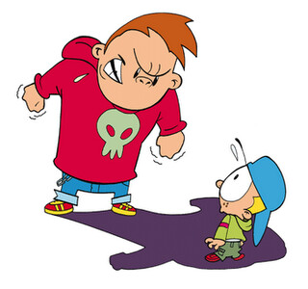
When Others Are Not Nice to Us

Slide 6
Moving to a New House

Slide 7
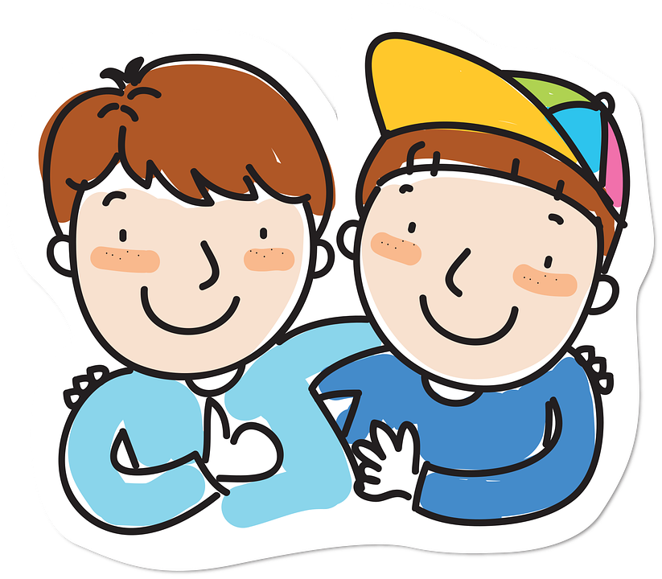
Your Best Friend Moves Away

